Slide 1
Algorithms and the Future of Work
John Howard
National Institute for Occupational Safety and Health
Centers for Disease Control and Prevention
U.S. Department of Health and Human Services
5 December 2022
California Industrial Hygiene Council
Marriott Hotel
Oakland, California

Slide 2
Overview
Futures
Future Technologies
AI Models
Algorithm Risks
Risk Governance

Slide 3
Strategic Foresight: A Futures Thinking Tool
© wildpixel; istockphoto.com

Slide 4
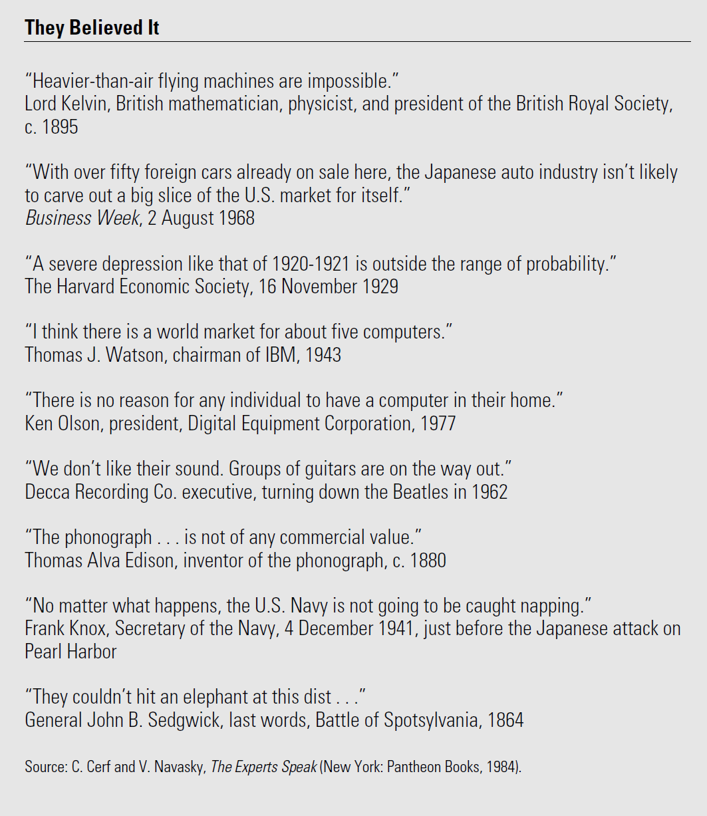
What is Strategic Foresight? www.cdc.gov/niosh/topics/foresight/
Strategic foresight is a futures thinking tool grounded in management sciences
Foresight does not predict the future, but it can help avoid surprises when the future arrives
Being surprised = futures planning failure
Future that occurs may not be the one you forecasted
Action-oriented planning discipline
Signals of change
Plausible future scenarios and strategic approach

Slide 5
Plausible Future Scenarios
Strategic foresight creates plausible future scenarios by scanning trends, faint signals, and emerging developments in the internal and external environment
Analyzing trends is easier if you use a STEEP trend analysis
Action-oriented planning discipline
Signals of change
Plausible future scenarios and strategic approach
Notes:
As a reminder, Strategic Foresight is an action-oriented planning discipline that is grounded in futures studies and strategic management. It creates well-informed future scenarios that help organizations better prepare for potential threats or take advantage of new opportunities. Scenario planning, the most common tool of Strategic Foresight, can help an organization test its current strategy, develop breakthrough innovations, or create transformative change.
We use scenarios, or stories from the future, to share findings in a way that humanizes topics that are often discussed through data, charts, and policy briefs. Scenarios help us experience the emerging trends and drivers shaping the future and better imagine how these diverse forces might interact.
A key insight about scenario planning is that the future is best understood from multiple perspectives. And, foresight does not predict the future, but it can help avoid surprise.

Slide 7
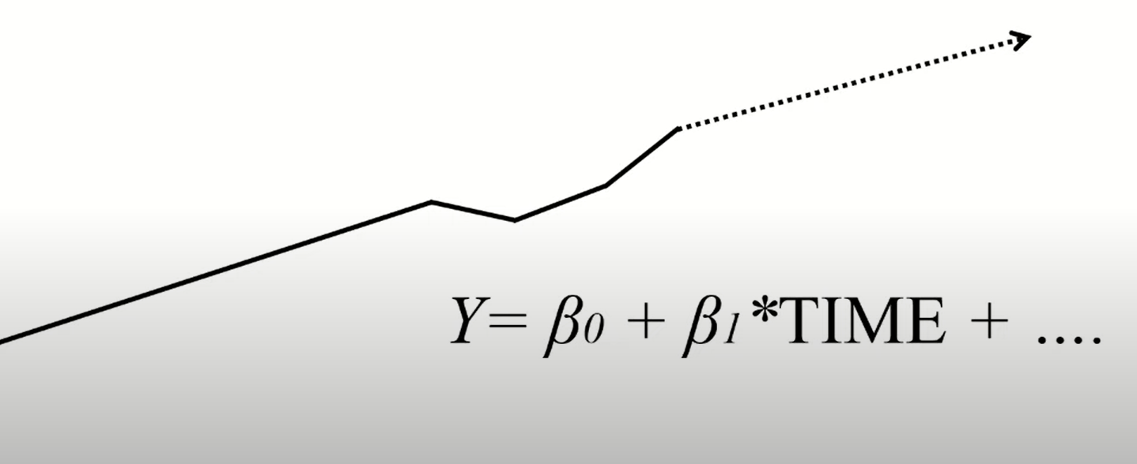
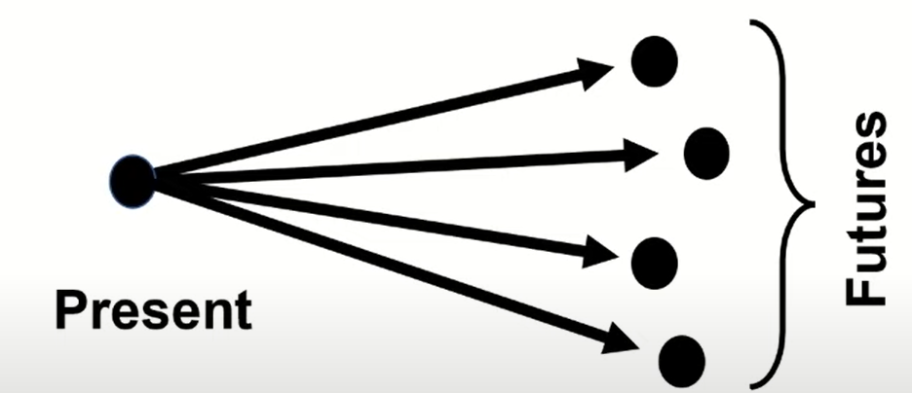
Forecasting versus Foresight
Forecasting
Uses quantitative data to fill in gaps and project one future
Data by its very nature is a snapshot of the past
Mathematically extrapolate to a single point estimate
Result is the promotion of a singular, linear, shortened “future”
Foresight
Incorporates mostly qualitative narratives based on scenarios into a holistic and nonlinear set of futures.
Complex system of variables not examined mathematically, but as multiple, sometimes conflicting, narratives
Medium-term future (5-20 years)
Long-term future (20-50 years)

Slide 8
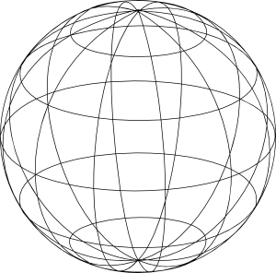
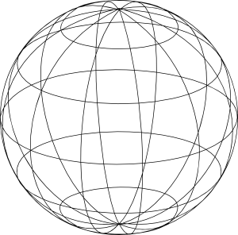
Forecast
Foresight
Cho Kong, 2022
Notes:
This scenario-based approach to planning demonstrates that the future is best understood from multiple perspectives, which can provide us with novel key insights. The scenarios, or stories of the future, that we create help us relate to alternative futures in a way that can’t be explained by charts, graphs, trendlines, or reports. Scenarios are unlike forecasts, which consider one view of the future based on one understanding of the present. Instead, scenarios consider multiple perspectives of the present by drawing from a range of sources. This helps us consider the different possible paths by which we might move from the present into the future.

Slide 9
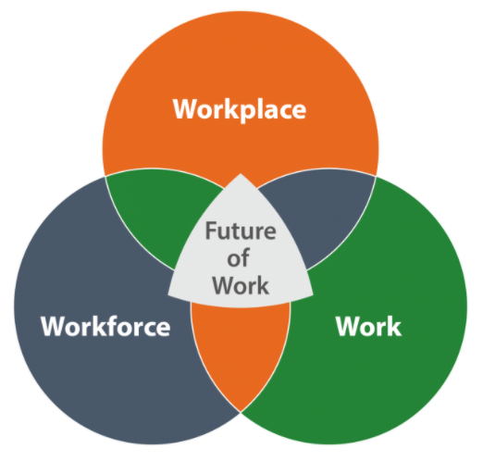
NIOSH Future of Work Initiative https://www.cdc.gov/niosh/topics/future-of-work/default.html
Goal
Research trends affecting the workplace, work technologies, and the workforce to create future scenarios
Objectives
Compile studies on the future of work
Promoting research into:
New industries
New technologies
New organizational designs
New work arrangements
New hazard and risk profiles
New ways to control risks

Slide 10
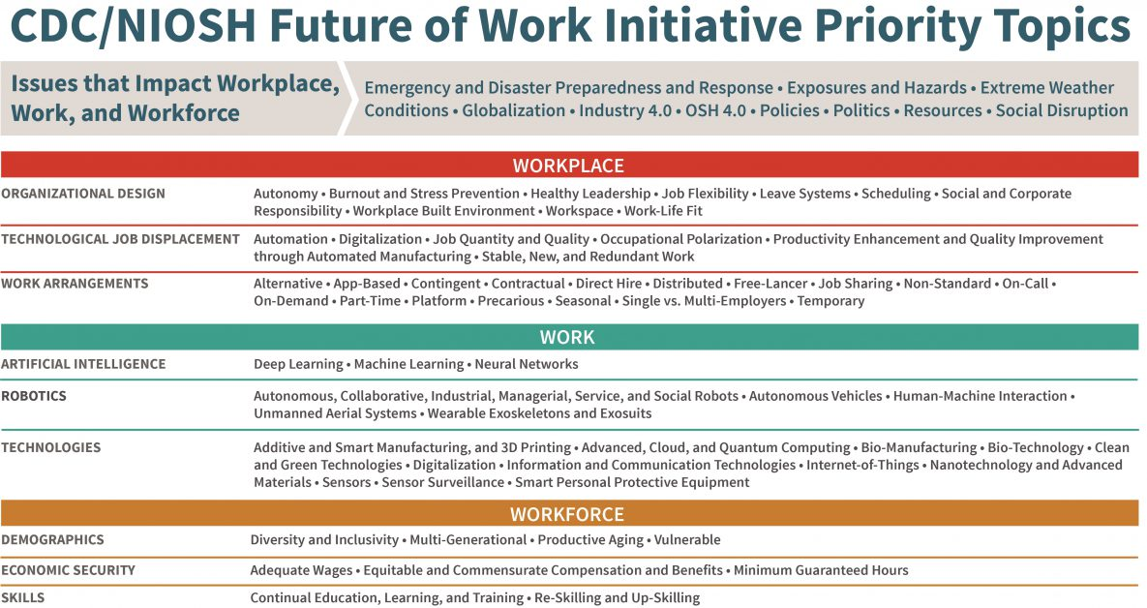
NIOSH Future of Work Trends
Tamers et al. (2020)
Notes:
The potential benefits of engaging in practices like strategic foresight to help us not only strategically prepare for, but also shape, the future become more crystallized as we consider the many complex – and potentially uncertain, chaotic, and ambiguous -- factors we have already identified as priorities for research and practice related to the future of work. The NIOSH Future of Work Initiative, for example, has developed a set of priority topics and subtopics to serve as a guiding framework for research and practice-based activities. The nine priority topics are based on an examination and synthesis of the literature and represent salient and interacting issues that are central to the future of work, with implications for the workplace, work, and the workforce.
The application of foresight to any combination of these issues can help expand the way we think about and plan for the future of work, which is not predetermined.

Slide 11
Key Technologies Enabling the Future
Additive manufacturing (3D printing)
Autonomous machines and systems
Human- Machine integration
Sensors
Artificial Intelligence
Robotics
Big data
Cloud Computing
Internet of Things
Source: OECD (2017)

Slide 12
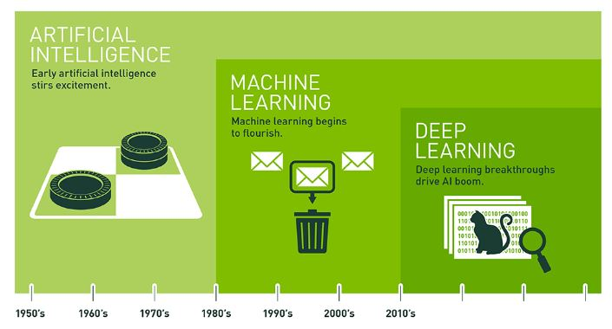

Slide 13
Artificial Intelligence
1955
New scientific field of study was born.
John McCarthy (Stanford) first used AI to describe the goal “…of making a machine behave in ways that would be called intelligent if a human being were so behaving.”
Machine Intelligence = Human Intelligence
AI’s goal is to build a machine that can replicate human intelligence, emphasizing skills that the human brain exhibits such as learning, reasoning and self-correction.
Machine intelligence equivalent to that of a human being is a powerful scientific and cultural construct, but it is a goal not yet achieved.
However, the use of sophisticated algorithms by computers across industry sectors has been moving us closer to AI’s goal.

Slide 14
AI Models

Slide 15
AI Model: Expert Systems
Early AI Application
First successful application of AI. Introduced in the 1970s and gained widespread popularity in the 1980s and 1990s.
Input/Output
Prior human knowledge/Decisions
Method
Use hard‐coded, rules‐based algorithms in a system that mimics the decision‐making ability of a human expert in a particular area of knowledge.
Domain experts develop a knowledge base and inference rules that can be used by an inference engine to deduce new information using condition (“IF”) and consequence (“THEN”) rules.
Known as good old‐fashioned AI (GOFAI), expert systems had early success, but eventual limitations caught up with expert systems.
Limitations
Representing an entire field of human knowledge with a finite set of rules requires a lot of effort on the part of domain experts.
Often, domain experts cannot always fully explain their reasoning, which makes engineering a knowledge base and inference rules challenging.
As any knowledge base grows, more rules must be added. Expert systems have no procedures to generate rules automatically; they must be updated manually, which takes time and resources.

Slide 16
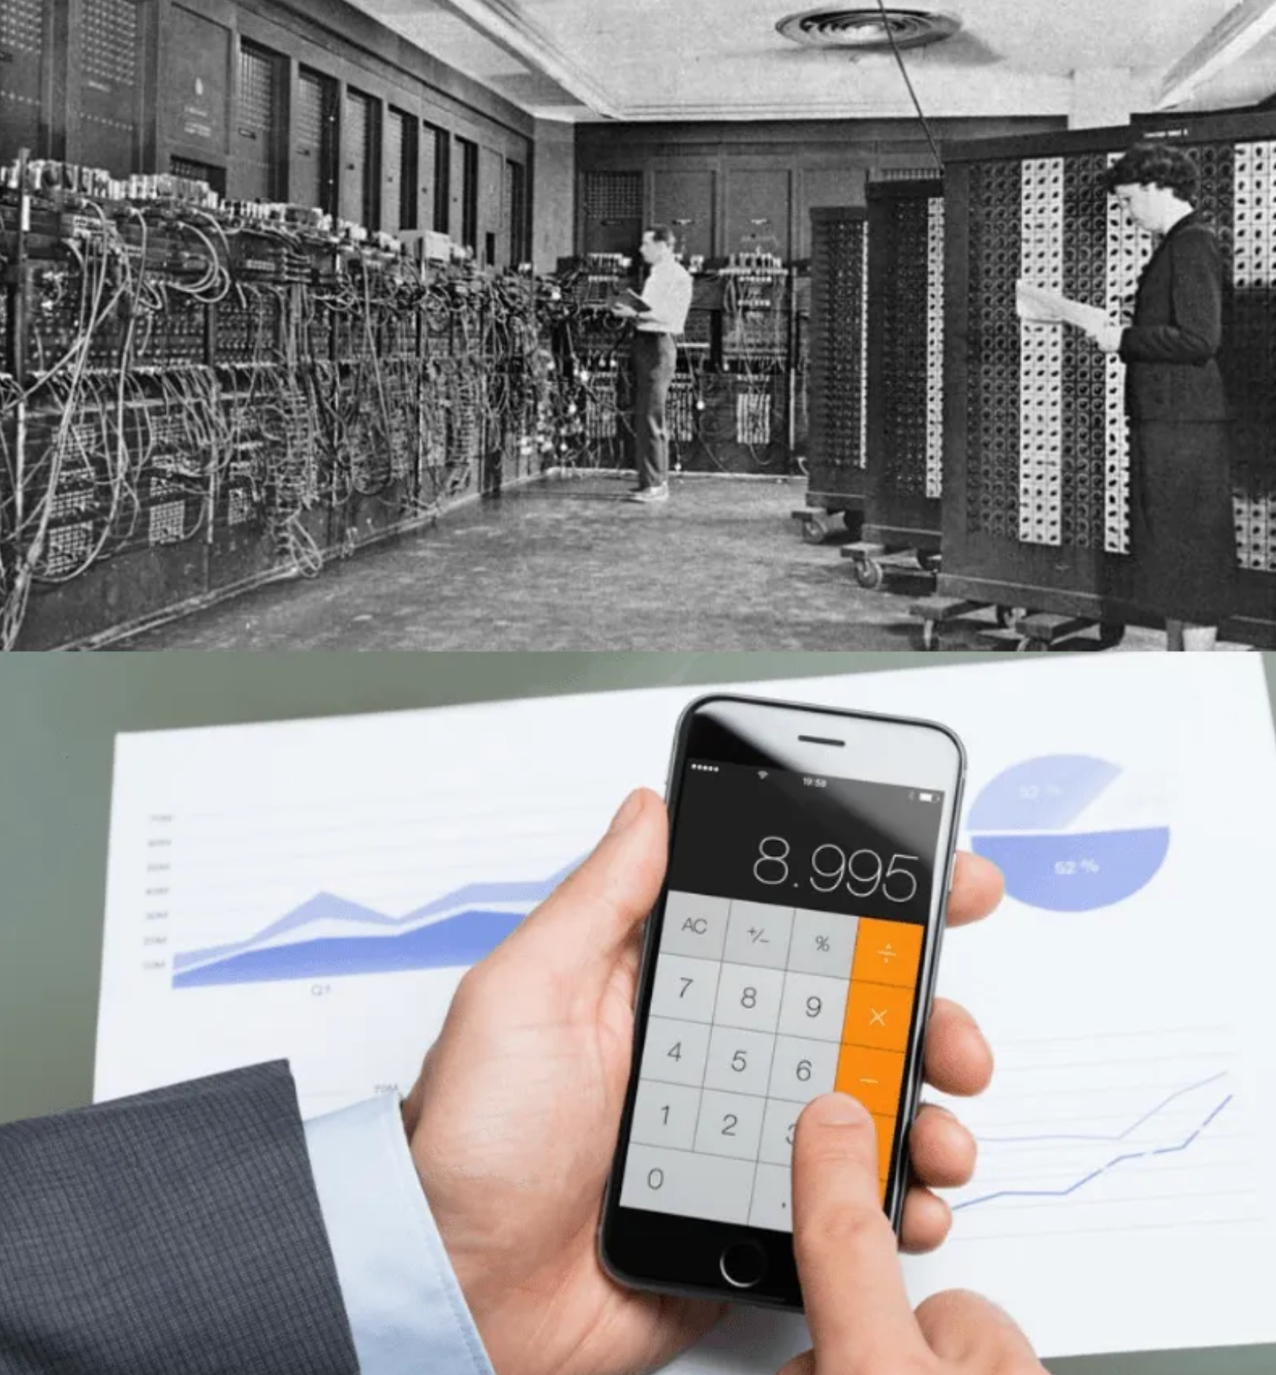
AI Model: Machine Learning
Machine Learning is the Major Form of AI in Use
Ability of computer systems to improve their performance by exposure to data – without the need to follow explicitly programmed instructions as in an expert system. Machine learning is the process of automatically spotting patterns in large amounts of data that can then be used to produce an outcome.
AI has grown exponentially due to 3 factors:
Explosion in computing power
Graphical processing units operating in parallel
Increase in storage capacity capabilities
Cloud computing
Accumulation of ‘Big Data’
Made possible by the Internet and collection of private digital data
Machine-learning Technology
Web searches
Content filtering on social networks
Recommendations on e-commerce websites
Natural language processing
Computer vision

Slide 17
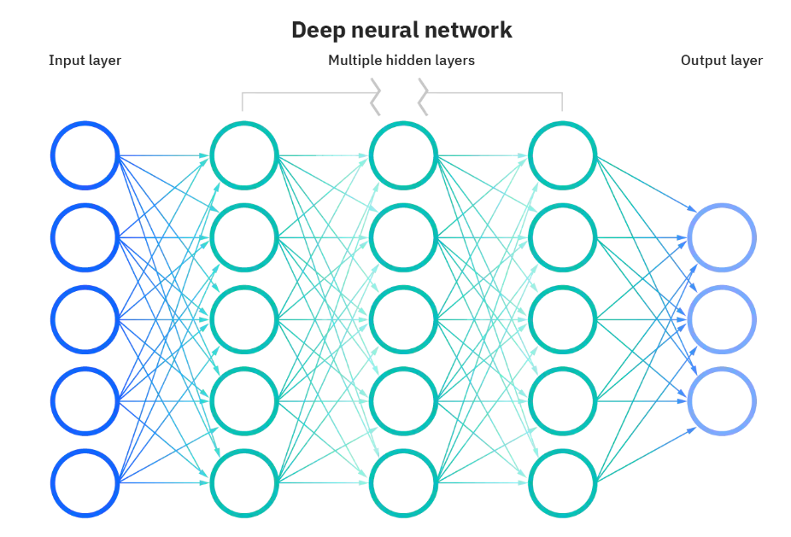
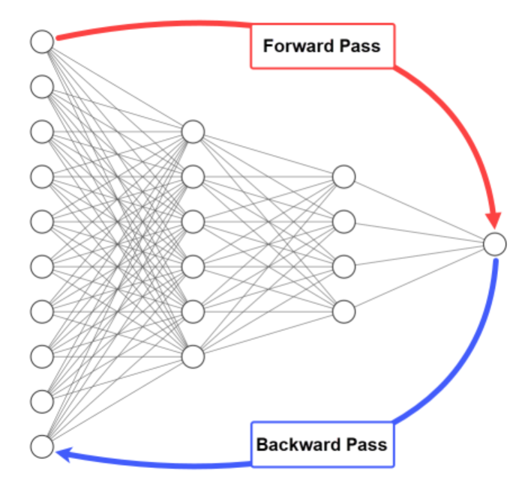
Subcategory of Machine Learning: Deep Neural Networks
Deep Learning: General Concept
Like neurons that are connected by synapses in the human brain, a network of engineered neurons can be trained to solve problems using a suite of algorithms.
GPUs enabled the one-layer networks in 1960s, and the two- to three-layer networks of the 1980s, to grow into the 10-, 15-, even 50-layer networks of today.
The “deep” in deep learning is just referring to the depth of layers in a neural network.
Neural Network Algorithms
Backpropagation algorithm emerged as a critical algorithm to improve the accuracy of a traditional feed‐forward neural network in achieving the desired outcome.
Major Advantages:
Less memory, compared to other optimization algorithms
Fast, especially for small and medium-sized networks
Generic, can work with different network architectures

Slide 18
Algorithm—Engine of AI
The term “algorithm” originated with the Persian astronomer and mathematician, Muhammad ibn Musa al‐Khwarizmi (c.780–c.850), known as the father of algebra.
His book on Arabic‐Hindu numerals and arithmetic, Al‐Khwārizmī On the Hindu Art of Reckoning, describes step‐by‐step methods for arithmetical calculation.
In the 12th century, a Latin translation of his book from the Arabic—Algoritmi de numero Indorum—began with the phrase Dixit Algorizmi – “Thus spake Al‐Khwarizmi”
“Algorithm” was derived from the Latinization of Al‐Khwarizmi's last name.

Slide 19
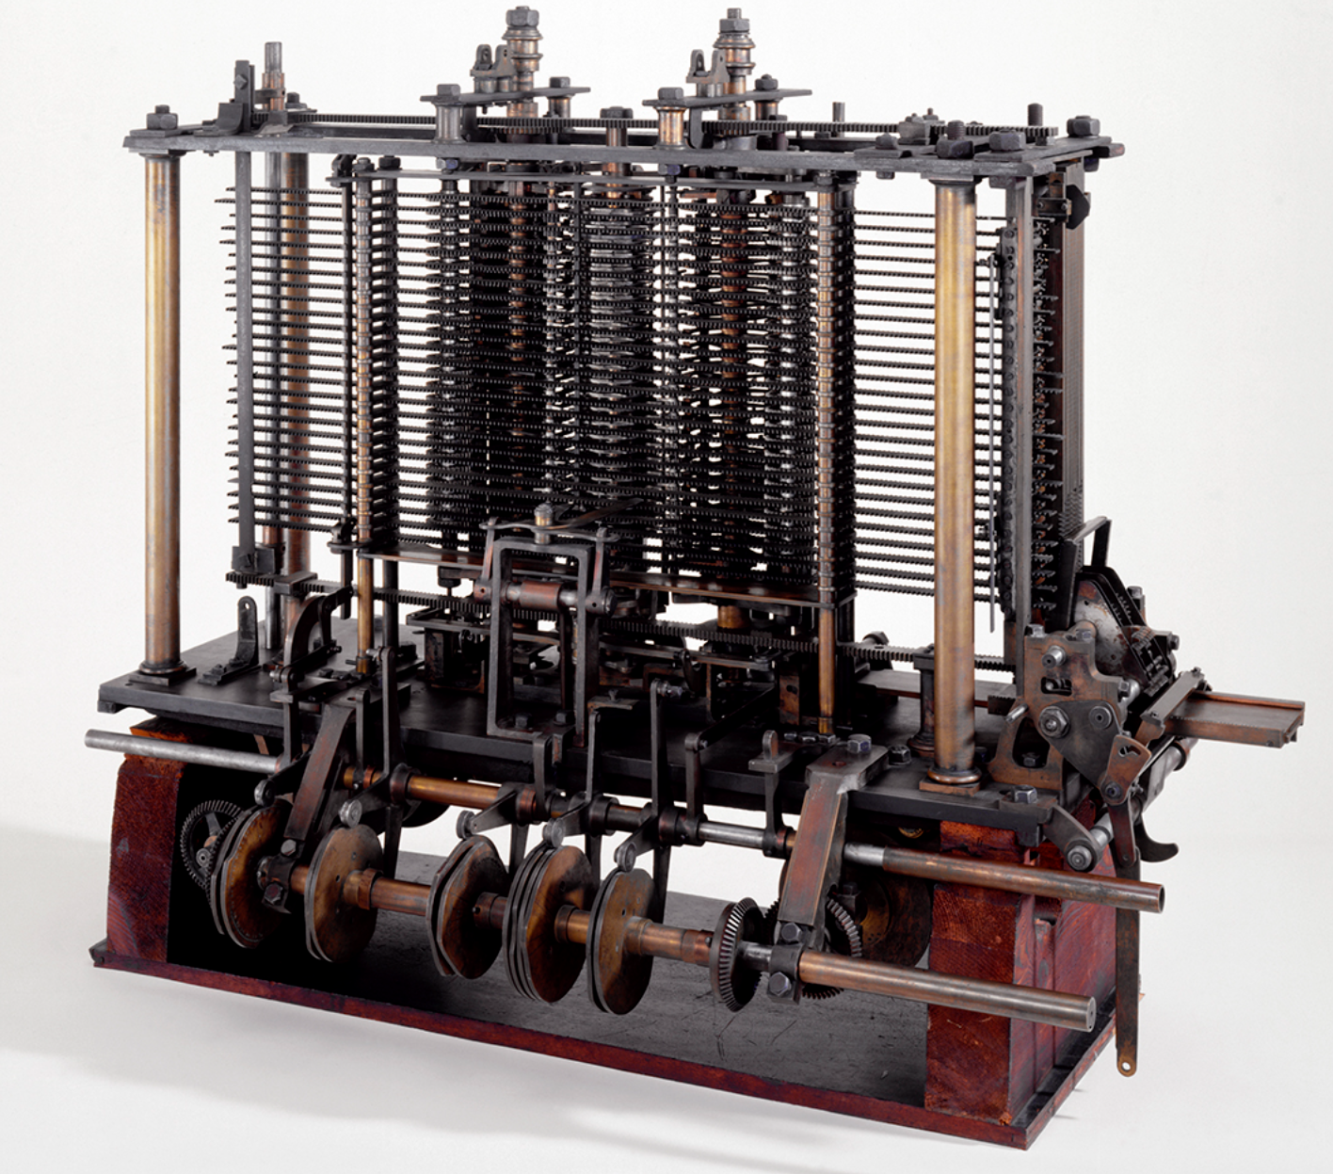
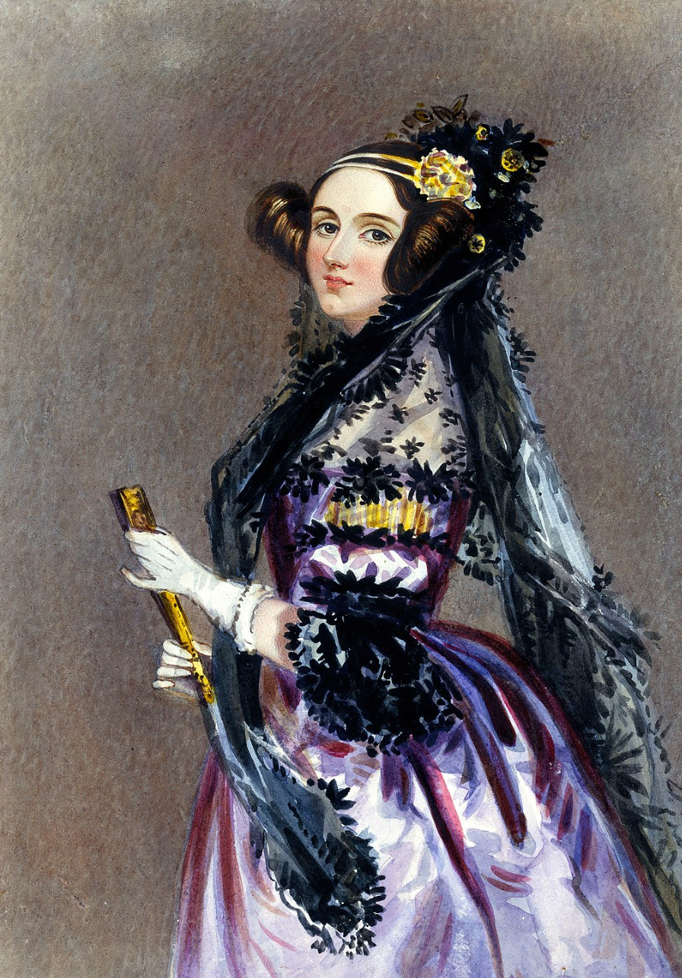
First Programmable Algorithm
Charles Babbage
In 1821, Charles Babbage is credited with inventing the first mechanical computer, the Difference Engine, that led in 1837 to his Analytical Engine which contained all the essential ideas of modern computers.
Ada Lovelace
In 1843, Ada Lovelace published the first algorithm designed to calculate Bernoulli numbers, a sequence of rational numbers, to be carried on the Analytical Engine. She is regarded as the first computer programmer.
Definition
In the present day, an algorithm refers to a series of precise, stepwise instructions used by a machine to perform a mathematical operation leading to the desired output.
But an algorithm is not just any set of instructions—they have to be precise and unambiguous enough to be executed by a computer in a language the computer understands like Java, C++, Ruby, R, Python or others.

Slide 20
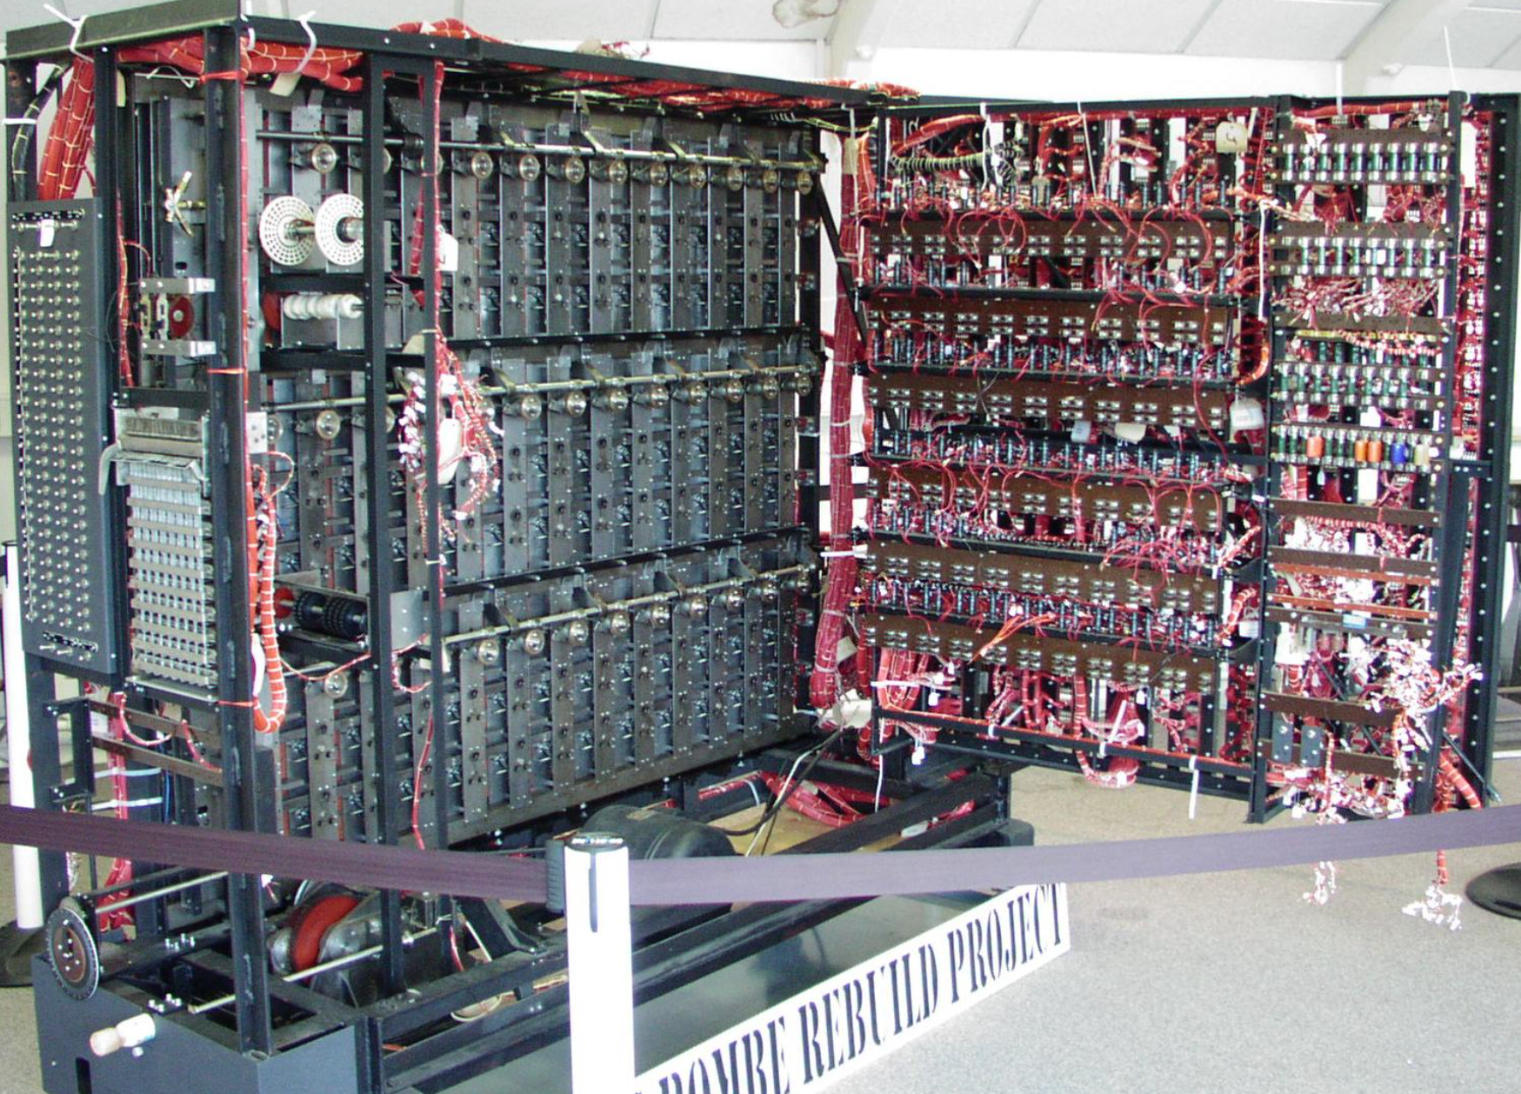
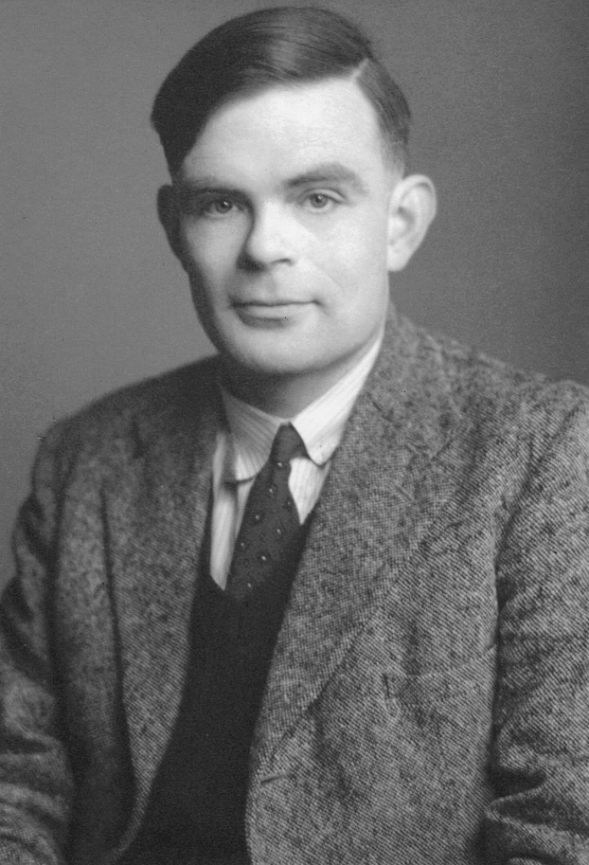
Modern Era
In 1937, Alan Turing developed a general‐purpose computational device that could be programmed using algorithms.
In 1945, Turing was recruited to the National Physical Laboratory (NPL) in London to create an electronic computer. His design for the Automatic Computing Engine (ACE) was the first complete specification of an electronic stored-program all-purpose digital computer.
Turing also wrote the first-ever programming manual, and his programming system was used in the Ferranti Mark I, the first marketable electronic digital computer (1951).
A computer's power to perform cognitive tasks eventually led to the general belief that human learning and reasoning could be duplicated by a machine.

Slide 21
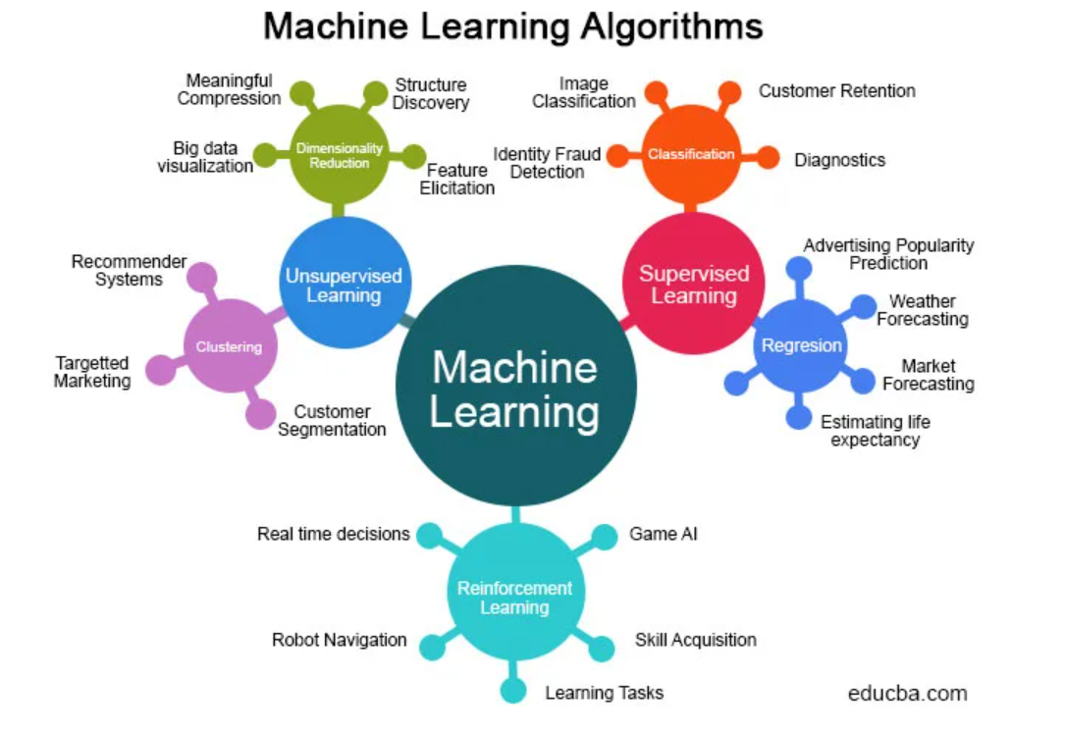
Sample of Machine Learning Algorithms
Supervised Learning
Support vector machine (SVM), naïve Bayes; K‐nearest neighbor; decision trees, random forests; and linear and logistic regression
Unsupervised Learning
K‐means, Markov decision process, principal component analysis, Gaussian mixture modeling, and backpropagation
Semi-supervised Learning
Self‐training, co‐training, generative methods, mixture models, semi-supervised SVM, and graph‐based modeling
Reinforcement Learning
Q‐learning, temporal difference, and deep adversarial networks

Slide 22
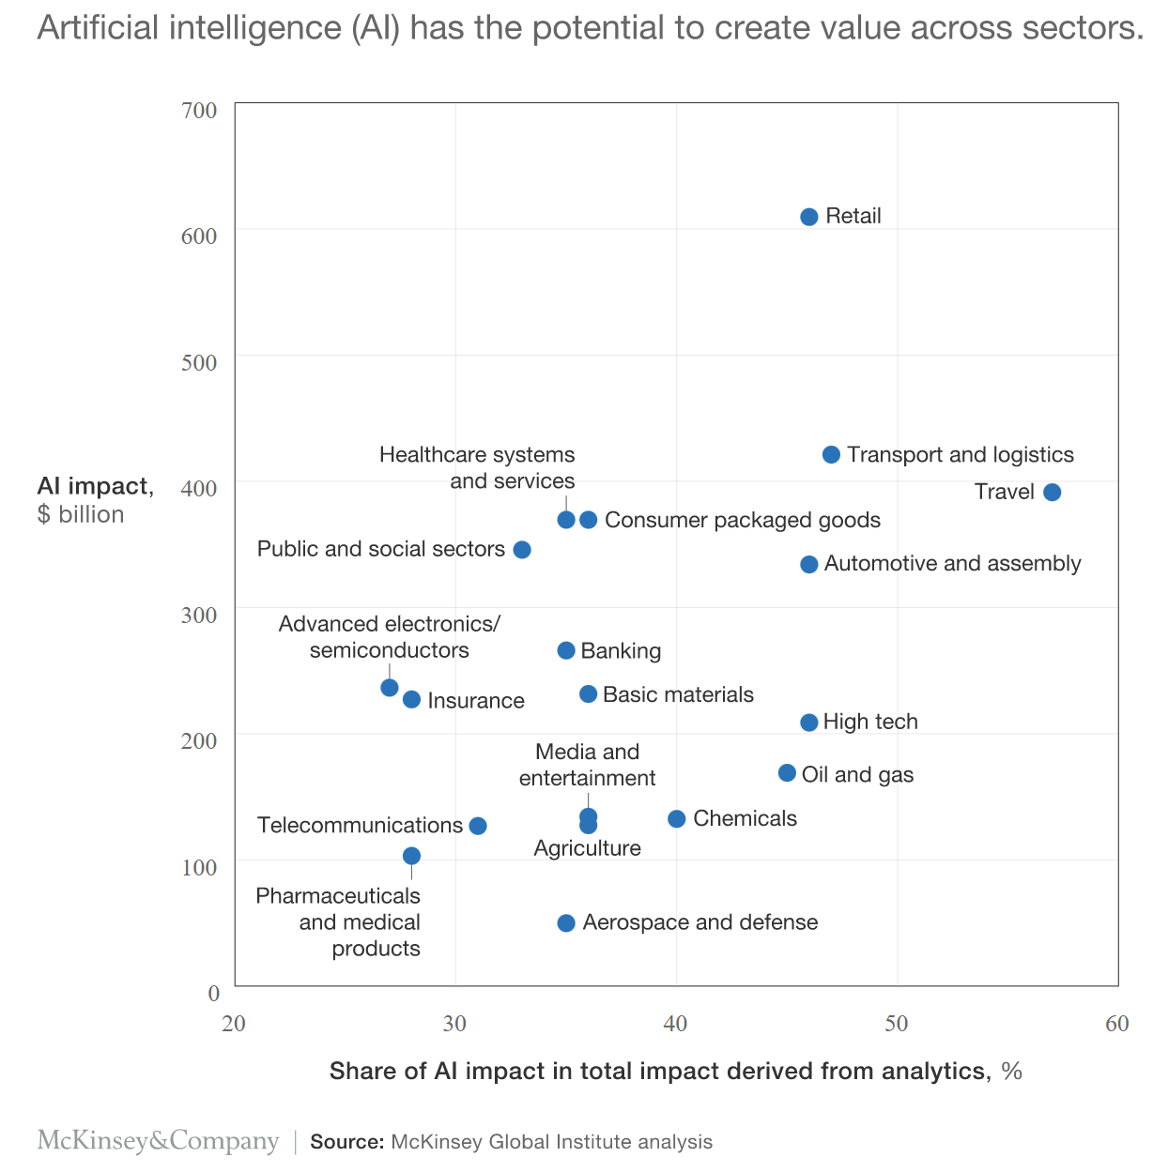
Algorithm-Enabled Systems in the Workplace
Future of Work Tools
Algorithm‐enabled systems and devices can be conceptualized as future‐of‐work tools that may one day tell you:
What happened (descriptive systems)
Why it happened (diagnostic systems)
Forecast what will happen (predictive systems)
Support decision‐making based on present and future conditions (prescriptive systems)
Take physical actions (semi‐autonomous and autonomous systems)
Industry Sectors
Manufacturing
Construction
Agriculture
Retail
Extractive Mining
Government

Slide 23
Algorithm Risks

Slide 24
Algorithm Risks
Input Risk
Errors and biases in input data or training data
Small data sets limitations
Algorithm Design
Biased logic, flawed assumptions in algorithm design or mistakes in coding
Customization vs. Standardization
Output Risk
User disregard of an algorithm’s limitations or underlying assumptions, leading to an inappropriate application or an incorrect interpretation of outputs
Complexity
Increasing complexity of proprietary algorithms—especially self‐learning algorithms which can change their decision logic during operation—make it difficult for designers, manufacturers, and users to gain an operational understanding about how an algorithm works and produces its outcomes.

Slide 25
Algorithm Risk: 2nd Level Risks
Lack of Transparency
Organizations unwilling to share algorithm source code or internal operations
Lack of algorithmic transparency can be a major impediment to the assessment and control of new occupational safety and health risks.
Lack of explainable algorithms hinders how to describe how the algorithm arrived at its decisions
Concept Drift
Disconnect between the parameters the algorithm was optimized for, and operating environment it finds itself
Market stability versus volatility
Differing shades of skin color and dermatological diagnosis
Changes in operating parameters of machinery versus design parameters
Lack of Standards
No widely-accepted cross-industry standards to govern many machine learning algorithms.

Slide 26
Risks in Context
Work Management
Advanced Sensor Technologies
Robotics

Slide 27
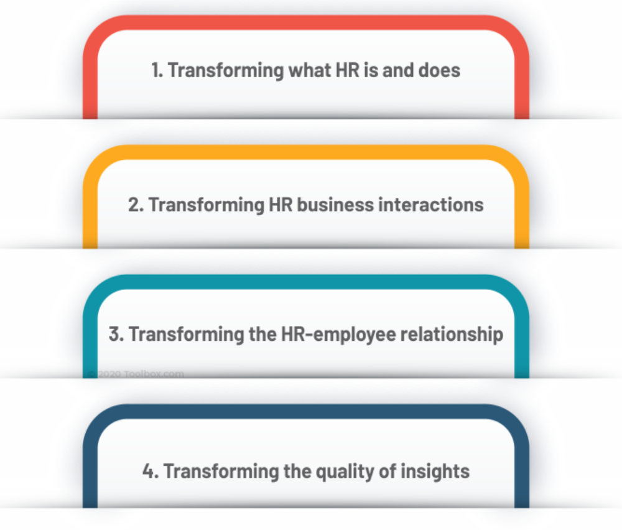
Algorithm Systems: Management
Methods of Supervision
Traditional
Close physical supervision
Emerging
Video surveillance track a worker’s physical movements through geolocation algorithms
Digitally monitoring an employee's use of email, social media, and web browsing
Assess a worker's productivity, level of engagement, propensity to leave the organization, and adherence to workplace safety behaviors.
“People Analytics”
These new data‐driven approaches to human resources management are referred to as “people analytics” and are touted as helping employers make better decisions.
Routine management style in gig industry.

Slide 28
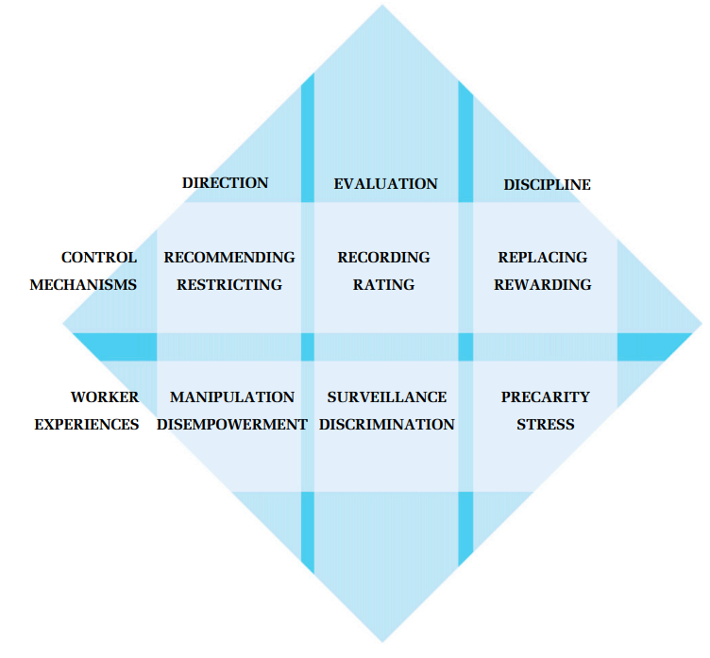
Algorithmic Management: General Risks
Forever Data
Algorithmic management techniques can collect and store worker data on a continuous basis, potentially without express purpose or worker disclosure.
Algorithm as Manager
Observer of the worker and the HR decision‐maker can both be nonhuman agents.
Algorithmic worker management systems can process collected data to produce a decision output and send that decision to a human or a machine to reward, discipline, or terminate a worker.
Erosion of Employer-Employee Relationship
When the organization, not the worker, is the primary beneficiary of algorithm‐enabled tools, and where bureaucratic control of the workplace is at stake, individual strategies of resistance to collective organizing—algoactivism—can emerge.
Diffusion of algorithmic management systems will affect the future of work but may do so in unintended and undesirable ways

Slide 29
Algorithmic Management: Specific Risks
Digital Taylorism and Loss of Autonomy
When algorithms are given power over a worker's job, and when the worker has no information or understanding of what data the algorithm is collecting, how the data are being used, and for what purpose, workers report feelings of powerlessness.
Data Persistence and Erosion of Worker Privacy
Presence of large amounts of information about a worker within an algorithmic‐enabled system presents a potential security risk. Data about a worker, once created, may persist indefinitely and algorithmic‐generated data could be repurposed without a worker's knowledge. If it falls into the wrong hands, may damage a worker's privacy interests.
Algorithmic Bias and Discriminatory Outcomes
Algorithmic bias occurs when an algorithmic‐enabled system's outputs advantage or disadvantage some individuals or groups more than others without a justified reason for the disparate impacts. The source of bias can arise from historical proclivities contained in the training data or from algorithm design choices.
Reliance on indiscriminate data mining may reproduce forms of discrimination set in motion by previous decision‐makers and may lead to occupational inequalities in hiring, retention, and termination, primarily adversely affecting minority workers.

Slide 30
Algorithm Systems: Advanced Sensor Technologies
Placeables
Sensors placed in and around the workplace to collect information from the ambient work environment.
Wearables
Attached
Workers
Attached to a worker’s clothing, head, arms, wrists, fingers, upper/lower body, or feet, worn as computer-display eyeglasses or contact lenses, or placed in the ear canal
Equipment
Attached to robotic devices as sophisticated sensing systems
Location and range sensors, proprioceptive sensors, force and torque sensors
Electronic textiles
Sensors that are woven into textiles that can be worn by a worker as clothing
Electronic epidermal wearables
Sensors incorporated in thin “skin-like” films or tattoos that can be applied directly to the epidermis
Implantables
Sensors that can be inserted into the skin via microneedles, microchips, or can be ingestible

Slide 31
Exposure Science Futures Electronic Textiles and Electronic Epidermal Sensors

Slide 32
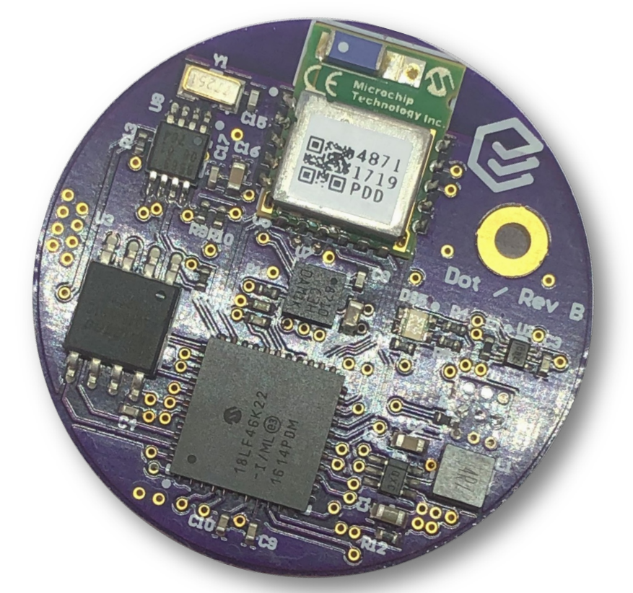
Algorithm-Enabled Sensor Systems
General
Sensors are new exposure assessment tools as they provide the data inputs for algorithmic controls.
Benefits
Advanced sensor technologies using miniaturized algorithm-embedded microprocessors have the potential to greatly accelerate advances in occupational exposure science by continuously sensing the ambient work environment for hazardous substances or a worker's proximity to known hazards.
Wearable and placeable sensors, linked wirelessly and capable of communicating with each other, can be deployed in the workplace as a sensor network system for multi-hazard safety and health applications.
Risks
Raise worker concerns over intrusive worker surveillance, algorithmic bias, and violation of personal privacy.

Slide 33
Algorithm-Enabled Sensor Network Systems
Complex Sensor Networks
As algorithmic complexity of a multi-sensor workplace network increases, operational risks to the network also increase, which require methods that maintain the network’s functional integrity.
Safety Failure Risk
A sensor integrated into a complex software program with multiple algorithms that are operating mechanical equipment may risk the safety of machinery operators
Dramatic Example
The most dramatic example of a sensor operating outside of design parameters involved the angle‐of‐attack (AoA) sensor embedded in a complex operational system on Boeing’s 737 Max aircraft. The AoA sensor sent faulty data to the Maneuvering Characteristics Augmentation System (MCAS) software, which caused the horizontal stabilizers to repeatedly pitch the airplanes down, overwhelming the pilots and causing them to lose control of the aircraft.

Slide 34
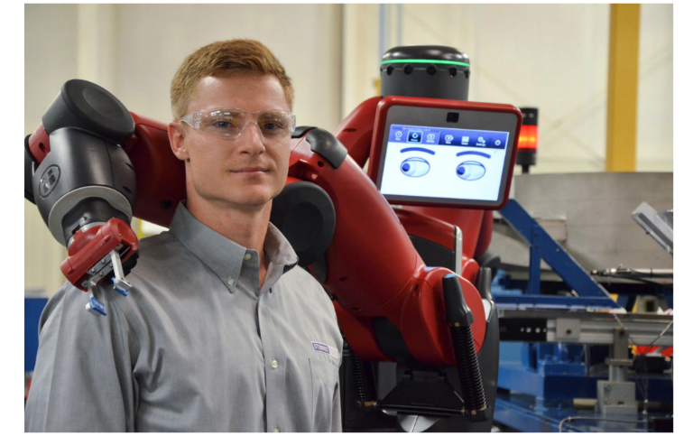
Algorithm-Enabled Systems: Robotics
Increased Role of Robotic Devices in the Workplace
Algorithms are critical components of all robotic devices. From an AI architectural perspective, robotic devices can be physically‐embodied robots or digital‐decision assistants.
Robot Functions—Sensing, Thinking and Acting
Perceptual sensing
Interprets input data from sensors detecting light, sound, location, navigation, position, proximity to other objects, movement speed, acceleration, voice commands, and other input data.
Thinking and Acting
Robotic motion is accomplished by the integration of a suite of classical machine learning algorithms, optimal value reinforcement learning algorithms, policy‐gradient learning algorithms and others.

Slide 35
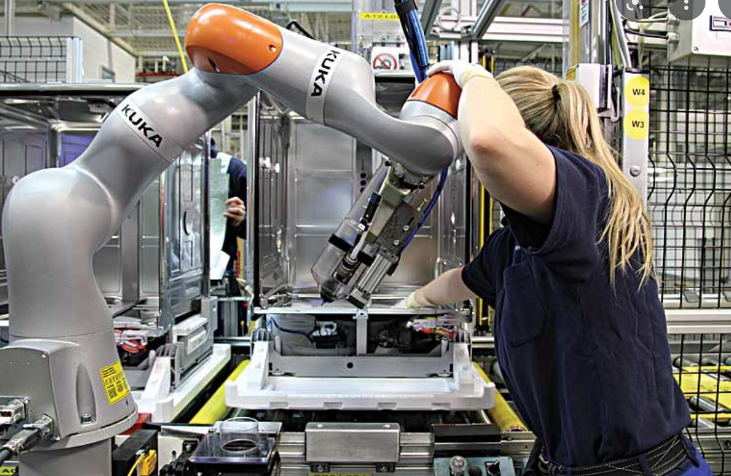
Algorithm-Enabled Robotic Systems
Collaborative Robots
Mobile‐arm manipulators and other newer robotic devices work alongside human workers
“Cobots,” combine the dexterity, flexibility, and problem‐solving skills of human workers with the strength, endurance, and precision of mechanical robots
Risks
Collisions
Unexpected actions by the robot or the human worker or inattention by the human worker
Security
Degradation of sensors designed to protect nearby human workers
Mismatch
A robotic system under algorithmic control can cause a mismatch between a human worker's physical or cognitive capabilities and robot work demands
Work Intensification
When robotic systems are designed to maximize productivity without adequately considering the impact on human workers' performance, work intensification can occur

Slide 36
Risk Governance
Risk Management
Legislation
Regulation
Legal Accountability

Slide 37
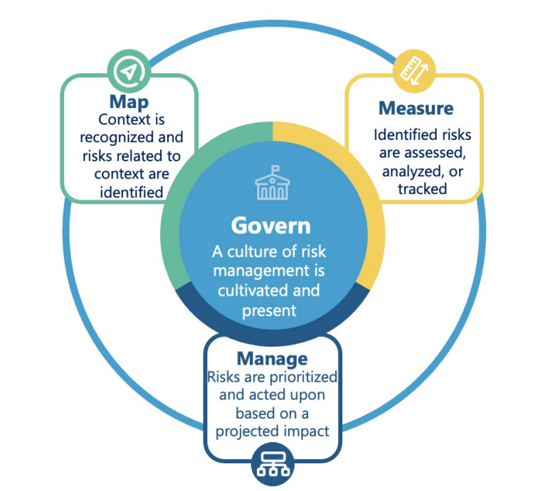
Risk Management https://www.nist.gov/system/files/documents/2022/08/18/AI_RMF_2nd_draft.pdf
Workplace Use of Algorithm‐enabled AI Systems/Devices
Accelerating faster than algorithm‐specific risk assessment/management can be developed.
Algorithm Risks Are Not Traditional Occupational Safety and Health Risks
When integrated into workplace systems, algorithms can present a unique taxonomy of risks that may not be addressed in an organization's traditional occupational safety and health risk management approaches.
New Risk Assessment and Risk Management Approaches
New methods are needed to detect biases in input data, find design errors in proprietary algorithms, and ensure that output decisions are logically derivative of the input data.

Slide 38
Risk Management
Challenges
Humans-in-the-Loop
In the case of algorithm‐enabled decision systems, the risk control strategy characterized by a human review of algorithmic outputs, called “humans‐in‐the‐loop,” is touted as an effective risk management tool. However, humans may not be that effective at algorithmic oversight.
Hard Stuff
Many algorithms are inherently opaque and therefore difficult to audit.
Easy Way Out
By not independently auditing your algorithms, you can remain blissfully ignorant and keep plausible deniability when it comes to negative consequences
Opportunities
Occupational Safety and Health Practice as Data Science
Analogous to the twin approaches to workplace safety management based on person versus system error, algorithmic safety management depends on close examination of all “upstream” factors—input data and algorithm design—to prevent “downstream” risks.
Skills in mathematics and computer science needed to understand how an algorithm produced a particular output
Algorithmic Hygiene
By implementing algorithmic bias detection and mitigation procedures—algorithmic hygiene—and subjecting algorithms to extensive testing before use, consequential decisions negatively affecting workers can be lessened

Slide 39
Challenge Questions
Does the safety and health professional have a solid understanding of where algorithms are currently deployed or where they want to deploy new algorithms?
Has the potential risks of those algorithms functioning outside safe bounds been evaluated?
Does senior management understand and support the need to manage algorithm risks?
Does the organization have clearly established risk management program for managing the risks that may arise from algorithm deployment?
Does that program contain strategies for rigorous testing algorithms prior to deployment and a system to monitor their activity after deployment?

Slide 40
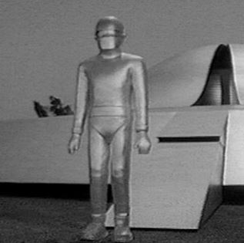
Algorithm-Enhanced Safety Management
Can algorithms be used to assist humans in recognizing a near-miss?
Can algorithms be used to assist humans to offer more accurate risk mitigation recommendations than humans can alone?
Can an algorithm take control to prevent human actions that may create safety and health hazards?

Slide 41
"I’m Sorry Dave, I’m Afraid I Can’t Do That"

Slide 42
Legislation https://doi.org/10.1007/s11023-022-09612-y
Emerging Trend
U.S. and in Europe are exploring legislation to promote algorithmic accountability
U.S.
Algorithmic Accountability Act of 2022 (AAA)
Introduced in Congress on 3 February 2022.
AAA directs the FTC to promulgate regulations that require any covered entity to conduct impact assessments of automated decision systems (ADS) before and after deployment.
https://www.congress.gov/bill/117th-congress/senate-bill/3572
Europe
Digital Services Act (DSA)
Requires platforms to provide transparency around their content moderation and algorithmic content curation efforts.
Artificial Intelligence Act (AIA)
In April 2021, European Commission submitted a draft proposal for a European Union regulatory framework for AI—The Artificial Intelligence Act (AIA).
AIA will create a process for self-certification and government oversight of many categories of high-risk AI systems, transparency requirements for AI systems that interact with people, and attempt to ban a few “unacceptable” qualities of AI systems. The Act imposes regulatory burdens only when the AI system is likely to pose high risks to fundamental rights or safety.
https://eur-lex.europa.eu/legal-content/EN/TXT/?uri=celex%3A52021PC0206
US/AAA Better Than EC/AIA
AAA captures the technical features—heterogeneous mix of machine learning algorithms—that we care about more than the more popularized term “AI systems” in the EC’s AIA.
AAA focuses on decision outputs avoiding questions about what an “AI system” is like the EC’s AIA.

Slide 43
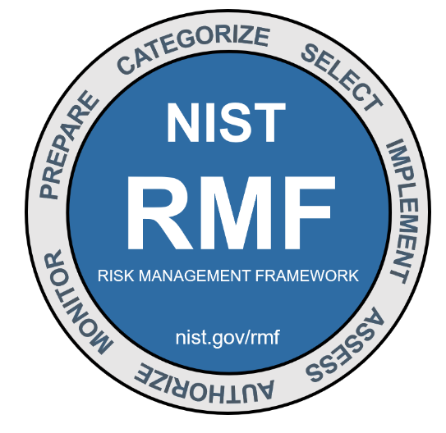
Regulation for USG
Executive Order 13859
11 February 2019, Executive Order 13859 directed OMB to provide guidance to all federal agencies on regulatory and nonregulatory approaches to AI as well as ways to reduce barriers to the development and adoption of AI technologies.
In a November 2020 memorandum, OMB directed federal agencies to provide their regulatory compliance plans by May 2021 consistent with a 2019 NIST's federal engagement plan for AI technical standards.
Executive Order 13960—3 December 2020
Sets out “9 Principles for Use of AI in Government.”
Lawful
Performance-driven
Accurate
Safe and resilient’
Understandable
Responsible and traceable
Regularly monitored
Transparent
Accountable
National Institute of Standards and Technology (NIST)
18 August 2022, NIST published 2nd draft of a framework—the NIST Artificial Intelligence Risk Management Framework—to better manage algorithm risks to individuals, organizations, and society.
https://www.nist.gov/system/files/documents/2022/08/18/AI_RMF_2nd_draft.pdf
18-19 October 2022, NIST AI Risk Management Framework Workshop #3
https://www.nist.gov/news-events/events/2022/10/building-nist-ai-risk-management-framework-workshop-3#:~:text=Now%2C%20help%20us%20take%20the,Framework%20(AI%20RMF)%20series.

Slide 44
Regulation Futures
“FDA for Algorithms”
Establish a government agency that would certify the safety of algorithm‐enabled systems and use legal incentives to compel designers, manufacturers, and sellers to ensure safe algorithms and internalize the costs of algorithm associated harms.
Agency would also be required to establish rules for precertification research and testing of algorithms.
These rules would permit developers to gather data and test their designs in secure environments so that the agency could make better-informed certification decisions.
https://jolt.law.harvard.edu/assets/articlePDFs/v30/30HarvJLTech1.pdf
“Private PTO for Algorithms”
Establish the equivalent of a government agency to oversee the registration of an algorithm before it is used commercially, just as patents undergo review before a limited monopoly is granted the patent owner.
https://administrativelawreview.org/wp-content/uploads/sites/2/2019/09/69-1-Andrew-Tutt.pdf

Slide 45
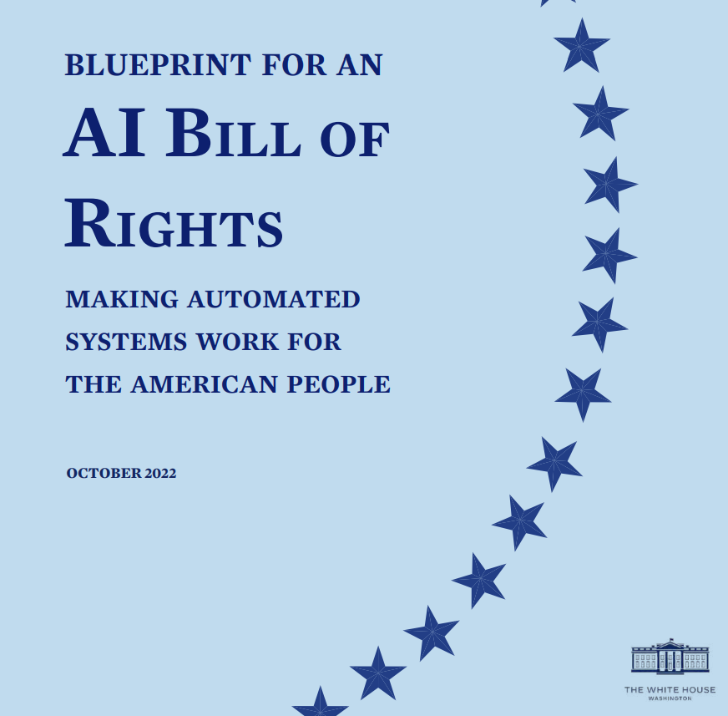
AI Bill of Rights https://www.whitehouse.gov/ostp/ai-bill-of-rights/
Provides an important framework of 5 principles for how government, tech, and citizens can work together to ensure more accountable AI.
Safe and Effective Systems
You should be protected from unsafe or ineffective systems.
Algorithmic Discrimination Protections
You should not face discrimination by algorithms and systems should be used and designed in an equitable way.
Data Privacy
You should be protected from abusive data practices via built-in protections, and you should have agency over how data about you is used.
Notice and Explanation
You should know that an automated system is being used and understand how and why it contributes to outcomes that impact you.
Alternative Options
You should be able to opt out, where appropriate, and have access to a person who can quickly consider and remedy problems you encounter.

Slide 46
Legal Accountability https://doi.org/10.1017/S1744137421000825
When machines can adjust their performance autonomously based on historical and real-time data, that’s machine intelligence.
As machine intelligence skills ↑
Need or desirability for human intervention may ↓
As a system’s ‘thinking’ becomes more ‘inscrutable’, human capacity to understand the algorithm falls behind.
Given the opacity of the system’s decisions, it is very difficult – and often unwise – for operators to second-guess and override the system’s decisions.
Assumption of legal risk?
May become difficult to attribute responsibility for injury or death to a specific party—algorithm designer, system programmer/manufacturer, employer or worker/user operator.
As algorithms take on more decision‐making roles in society and at the workplace, they will continue to challenge the existing principles of legal accountability in negligence and products liability law.

Slide 47
Algorithms and the Future of Work: Summary
Benefits and Risks
While algorithms will provide many beneficial applications in occupational safety and health such as reducing the sources of human error, algorithms may also introduce new sources of risks to workers.
Risk Management Challenge
Determining that an algorithm is safe for use in workplace systems or devices will challenge the risk assessment/management capabilities of algorithm designers and software programmers, equipment manufacturers, employers, worker-operators, and occupational safety and health practitioners.
Future is Now
To ensure that the benefits of algorithm‐enabled systems and devices have a prominent place in their responsible use in the future of work, now is the time to identify and control their risks.

Slide 48
