Slide 1
California Industrial Hygiene Council Overview and Update December 5, 2022
Pamela Murcell, MS, CIH
President
California Industrial Hygiene Council (CIHC)

Slide 2
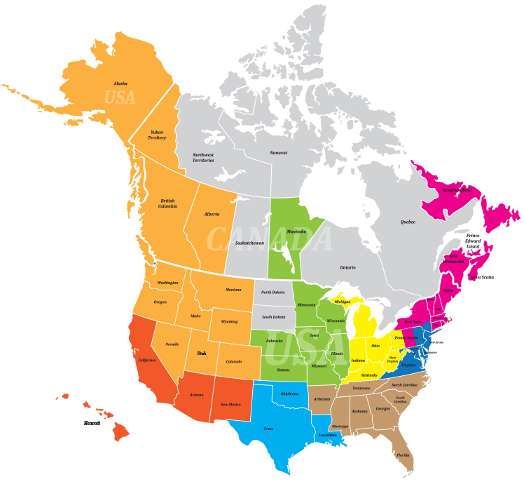
CIHC Profile
Founded in 1990 to establish a legislative presence in Sacramento
Volunteer organization supported by the 5 California AIHA* local sections
Northern California
Sacramento Valley
Southern California
Orange County
San Diego
*Pacific Region

Slide 3
CIHC Mission
The CIHC will provide sound scientific and technological input to the regulatory and legislative process and establish a legislative presence in the state Capitol.

Slide 4
What we do
The activities of the CIHC include the following:
Review, comment and participate in applicable California legislative and regulatory actions, providing scientific and technological expertise.
Propose legislation promoting and supporting good industrial/occupational hygiene practice in California.
Promote professional development through annual conferences, active involvement in emerging issues, training, and communications with stakeholders.
Hold regular Board meetings each year (in 2022, 1 in-person, 5 via Zoom); minutes are posted on the CIHC website.

Slide 5
2022 Activities Communication
CIHC Board meetings minutes – posted online
Legislative (Bill) Report – posted online
Email blasts – Webinar 2022, newsletters, items of general interest, PDS 2022
Publicized through peer to peer communication.

Slide 6
2022 Activities Legislative
Screened several hundred new and carry-over bills of interest in the 2022 legislative session (year two of the 2-year session)
Using CapitolTracks bill-tracking software to facilitate screening and bill status
tracked 26 bills of interest (14 failed and 12 signed by the Governor)
CIHC can always use your technical expertise!

Slide 7
2022 Bills with particular activity signed into Law
AB 257 Food Facilities and Employment – requires establishing the Fast Food Council in Dept of Industrial Relations to address minimum standards for fast food workers health and safety among other issues relevant to this industry
AB 1643 Labor and Workforce Development Agency: heat: advisory committee study – establish an advisory committee to study and evaluate the effects of heat on California’s workers, businesses, and the economy.
AB 1775 Occupational safety: live events – requires compliance with specified training, certification, and workforce requirements for this industry
AB 2238 Extreme heat: statewide extreme heat ranking system – requires the CalEPA, by January 1, 2025, to develop a statewide extreme heat ranking system in coordination with the ICARP, the CA Dept of Public Health, and the CA Dept of Insurance
CIHC can always use your technical expertise!
Notes:
Integrated Climate Adaptation and Resiliency Program (ICARP) – Advancing equitable, integrated climate adaptation and resilience solutions across local, regional, and state efforts; this is located in the Governor’s Office of Planning and Research

Slide 8
2022 Bills with particular activity signed into Law
AB 2243 Occupational safety and health standards: heat illness: wildfire smoke – requires the Division of Occupational Safety and Health, before December 1, 2025, to submit to the Standards Board a rulemaking proposal to consider revising the heat illness standard and wildfire smoke standard
AB 2693 COVID-19: exposure – authorizes the Division of Occupational Safety and Health to prohibit the performance of an operation or process, or entry into that place of employment when, in its opinion, a place of employment, operation, or process, or any part thereof, exposes workers to the risk of infection with COVID-19, so as to constitute an imminent hazard to employees; these provisions extend until January 1, 2024
CIHC can always use your technical expertise!

Slide 9
2022 Bills with particular activity signed into Law
SB 1076 Lead-based paint – requires CA Dept of Public Health to review and amend its regulations governing lead-related construction work, including training and certification for workers and accreditation for trainers in lead-safe work practices, to comply with existing state regulations and the US EPA’s Lead Renovation, Repair, and Painting Rule, as specified
CIHC can always use your technical expertise!

Slide 10
2022 Activities Regulatory
Occupational Safety & Health Standards Board (monthly meetings)
Health Effects Advisory Committee (none in 2020, 2021 or 2022)
Cal/OSHA Advisory Committee (Mar/July/Nov 2022)
COVID ETS Advisory Committee (Dec 2020; Feb – 3 days/Sept 2021; none in 2022)
5199 ATD Advisory Committee (Oct 2021; none in 2022)
All other DOSH health regulations advisory committees had no activity
Progress is reported during CIHC Board meetings.
Notes:
Aerosol Transmissible Disease (ATD) standard does have proposed revised language available as of Oct 2021 (reference ATD advisory committee information).

Slide 11
2022 Activities Regulatory
COVID-19 Prevention was the primary issue again!
CIHC provided written comments to Cal/OSHA and verbal comments during meetings on the ETS and proposed non-emergency regulation
Active in the emergency regulation process
Active in the non-emergency regulation process
Progress is reported during CIHC Board meetings.

Slide 12
Activities Continue
4-hour webinar via Zoom in March 2022
30th Annual Professional Development Seminar in Dec 2021 (in-person in Long Beach and virtual)
31st Annual Professional Development Seminar in Dec 2022 (in-person in Oakland and virtual)
Revised CIHC 5-year strategic plan; posted on CIHC website, 2022-2026 Strategic Plan
2022 newsletters (April and November); posted on CIHC website
Publicized through peer to peer communication.

Slide 13
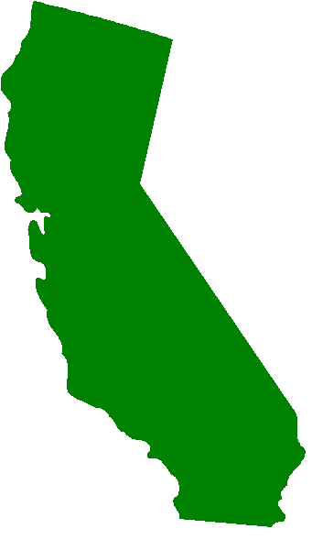
CIHC Board Members
Northern CA
Richard Hirsh
Laurel Davis
Patty Beach (Alternate)
Sacramento Valley
Ed Klinenberg (Immediate Past President)
Pamela Murcell (President)
Roxanne Fynboh (Secretary)
Southern CA
Jaime Steedman-Lyde (Co-VP)
Susan Gulbrandsen
Open (Alternate)
Orange County
Howard Spielman
Sam Celly
Joel Berman (Alternate)
San Diego
Megan Canright (Co-VP)
Gloria Chan (Treasurer)
Ann Graham (Alternate)
Representative of industry, government, and academia.

Slide 14
Enjoy the seminar!
Notes:
Closing remarks.

