Slide 1
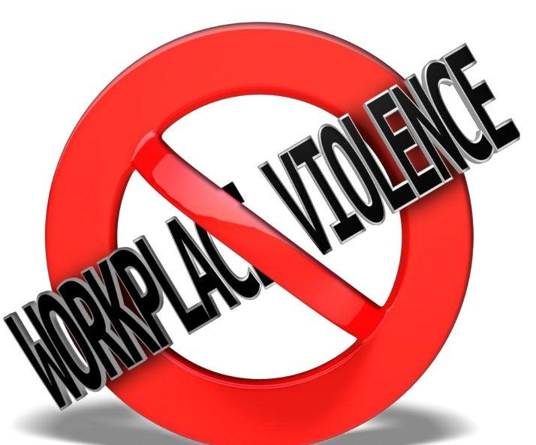
Violence—A Hybrid Workplace: A Public Health Issue
California Industrial Hygiene Association
December 5, 2022
Dr. John Comiskey
Monmouth University
R.E.M Risk Consultants

Slide 2
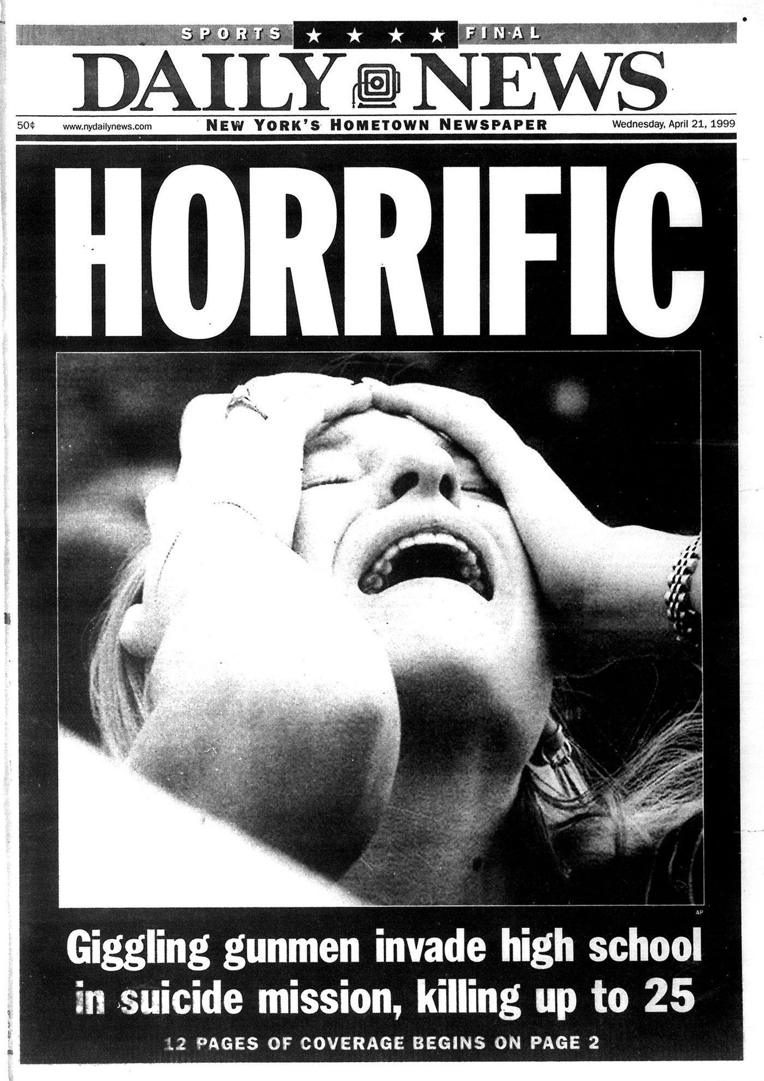
Dr. John Comiskey
Professor of Homeland Security at Monmouth University
CDC WTC Health Program
CHDS, HsX Think Tank Co-Founder
R.E.M Risk Consultants
NYPD Lieutenant (ret.)
U.S. Coast Guard (ret.)

Slide 3
Purpose
Changing Workplaces
Violence
Threat Landscape
Prevention

Slide 4
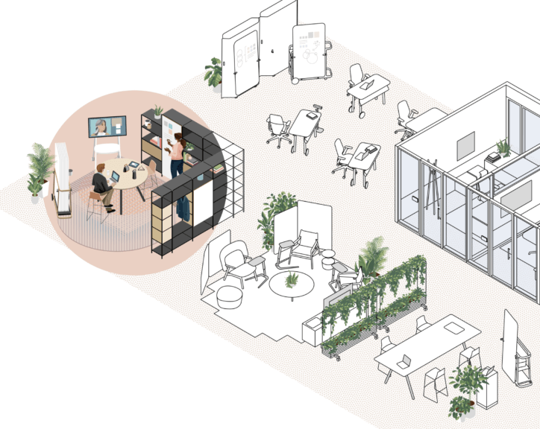
Future of Work
Great Resignation
Gig Economy
Remote/hybrid work
Automation

Slide 5
We are generally insulated from violence.
If there is trouble, call 911.
Responsibility (“It’s not my problem”).
Denial (“It won’t happen to me”).
Discussions of violence are “rude” or “inappropriate.”
“Zero-tolerance” policies

Slide 6
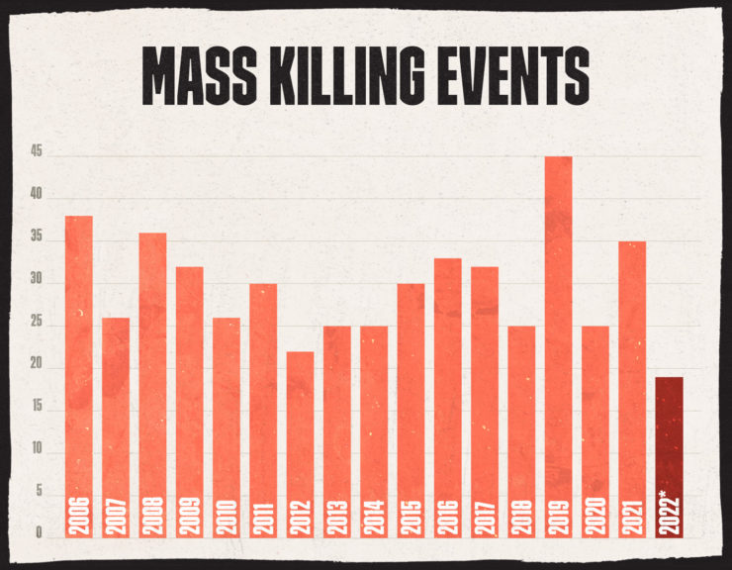
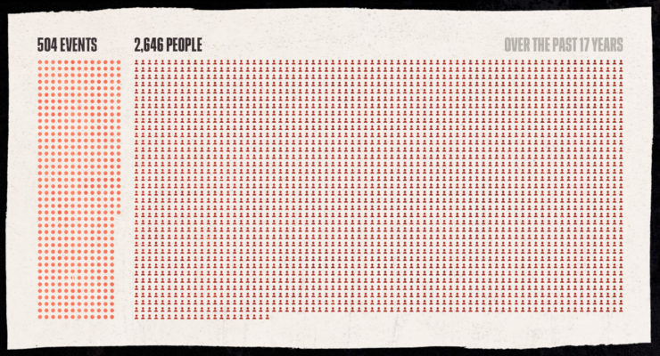
Threat Landscape
Workplace Violence
Hate Crime
Domestic Violence
Terrorism
(Northeastern University, 2022; DOJ, 2022a, 2022c)
Notes:
1.3 million violent crimes (20% is domestic violence)
22,000 murders (2021)
8,052 hate crimes (2020)
7,103 (2019)
51 terrorist deaths USA
10 million domestic violence victims

Slide 8
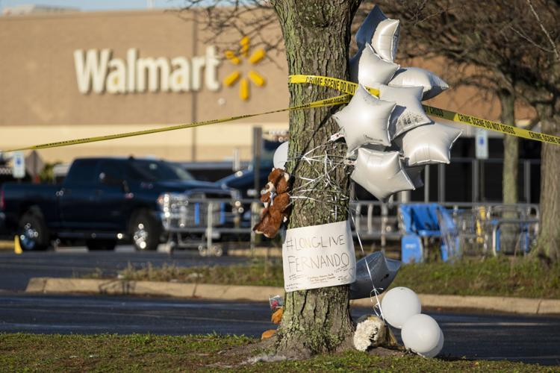
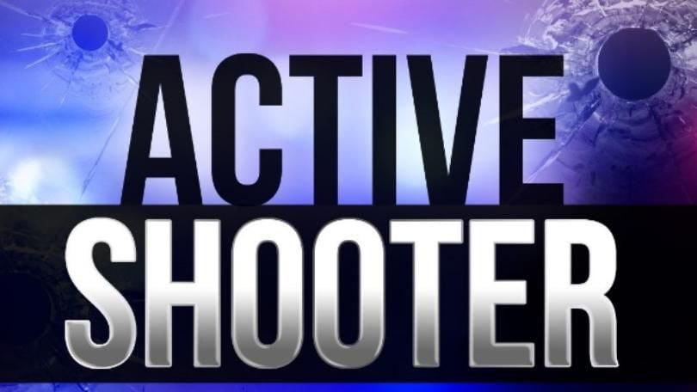
2021 Active Shooter Data (DOJ, 2022b)
51% of attacks occurred in the workplace.
57% of attackers were insiders.
37% of attacks ended in under 5 minutes, while the average attack lasted 12 minutes.
71% of the victims initially targeted were the focus of perceived injustice.
74% of attackers entered through the main entrance.

Slide 9
2 million workplace violence incidents annually.
Protective Services and Healthcare workers are most often affected (DOJ, 2022).
44% of nurses reported workplace violence attacks & 68% reported verbal abuse (AHA, 2022).
60% of teachers reported workplace violence (NPR, 2022).
48% of HR professionals have dealt with workplace violence (SHRM, 2022)

Slide 10
Why the Increase in Mass Shootings?
Contagion Impact.
The Internet (networking).
Social Media.
Social Unrest.
Lack of Prosecution.
Increase in Stressors.
Feedback loops have “normalized” violence.
Notes:
Kissner, J. Are Active Shootings Temporally Contagious? An Empirical Assessment. J Police Crim Psych 31, 48–58 (2016). https://doi.org/10.1007/s11896-015-9163-8

Slide 11
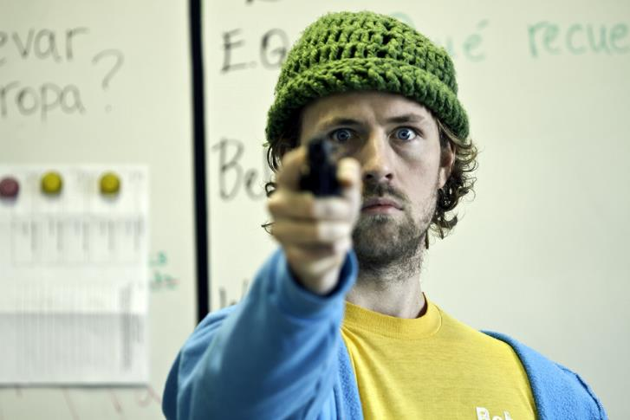
Prevention
Plan for the unthinkable.
See something, say something.
Protective measures.
Programs, policies, training
Threat Assessments

Slide 12
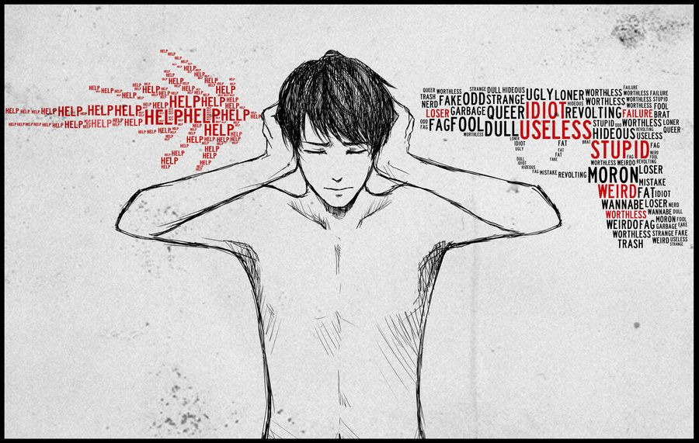
Active Shooter Profile
Experienced psychological trauma/exposure to violence at a young age.
Reached an identifiable crisis point in the week/months leading to the event.
Studied the actions of other mass shooters and sought out validation for motives.
They have fan clubs.
Had means to carry out their plans.
Notes:
Experienced psychological trauma / exposure to violence at a young age.
Parental Suicide.
Physical / sexual abuse.
Neglect.
Domestic Violence.
Bullying.
Studied the actions of other shooters, sought out validation for motives.
Social media / networking.
Social contagion.
Had means to carry out their plans.
Firearms.
Site accessibility.

Slide 13
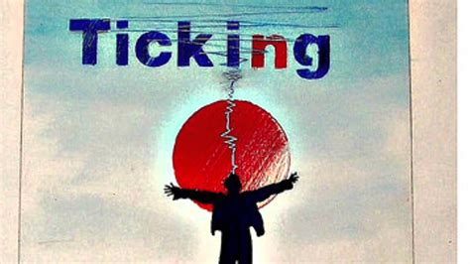

Slide 14
Indicators
Grievances.
Anger.
Suicidal ideation.
Decrease in productivity.
Unusual absenteeism.
Abrupt changes in financial situation.
Destruction of property, theft, sabotage.
Fame seeking.
Interest in past mass shootings.
Notes:
Context matters
Difficult to distinguish serious from nonserious threats

Slide 15
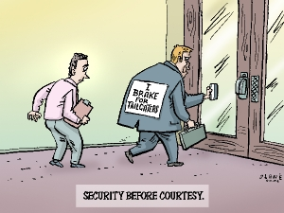
Protective Measures
Workplace Violence Program
Workplace Violence Training
Employee Engagement
Reporting Mechanisms
Access Control
CCTV
Exterior Lighting

Slide 16
Aftermath
Business Continuity
Caring for the victims, survivors, and families
Community reaction
Observations and Memorials
Litigation
Counseling

Slide 17
References
American Hospital Assoc (2022). Workplace Violence and Intimidation
FBI. (2022). Active Shooters in the United States
Department of Justice. (2022a). Indicators of Workplace Violence
Department of Justice. (2022b). Mass Shootings in American Cities
Department of Justice (2022c). Hate Crime in the U.S.
Levin & Madfis (2019). Mass Murder at School & Cumulative Strain
NIOSH (2017) Fundamentals of Total Worker Health
Northeastern University. (2022). Mass Shooting Database
Riedman (2022) K-12 School Shooting Data Base
Society of Human Resource Mgmt. (2022). Workplace Violence
Tiesman (2022) Workplace violence, mental health public health workers

