Slide 1
IH Challenges in Pharma
December 5, 2022
Debbie Keys, CIH, CHMM

Slide 2
Acronyms
Ab: Antibody
API: Active Pharmaceutical Ingredient
ASL: Acceptable Surface Limit
CMO: Contract Manufacturing Organization
CPT: Containment Performance Target
CRO: Contract Research Organization
GHS: Globally Harmonized System
HD: Hazardous Drug
OEL: Occupational Exposure Limit
PEL: Permissible Exposure Limit
USP: United States Pharmacopeia
VC: Venture Capital

Slide 3



Objectives
What are potent compounds?
What Business Drivers make IH in Pharma challenging?
What ideas can I implement at my job?
Notes:
Low OELs.
_____________________
These compounds have extremely low Occupational Exposure Limits, or OELs. They are part of our products, which make sick people well or otherwise improve their lives. However, we have a unique challenge in that if these compounds are not properly handled, they can make well people, our employees, sick.

Slide 4
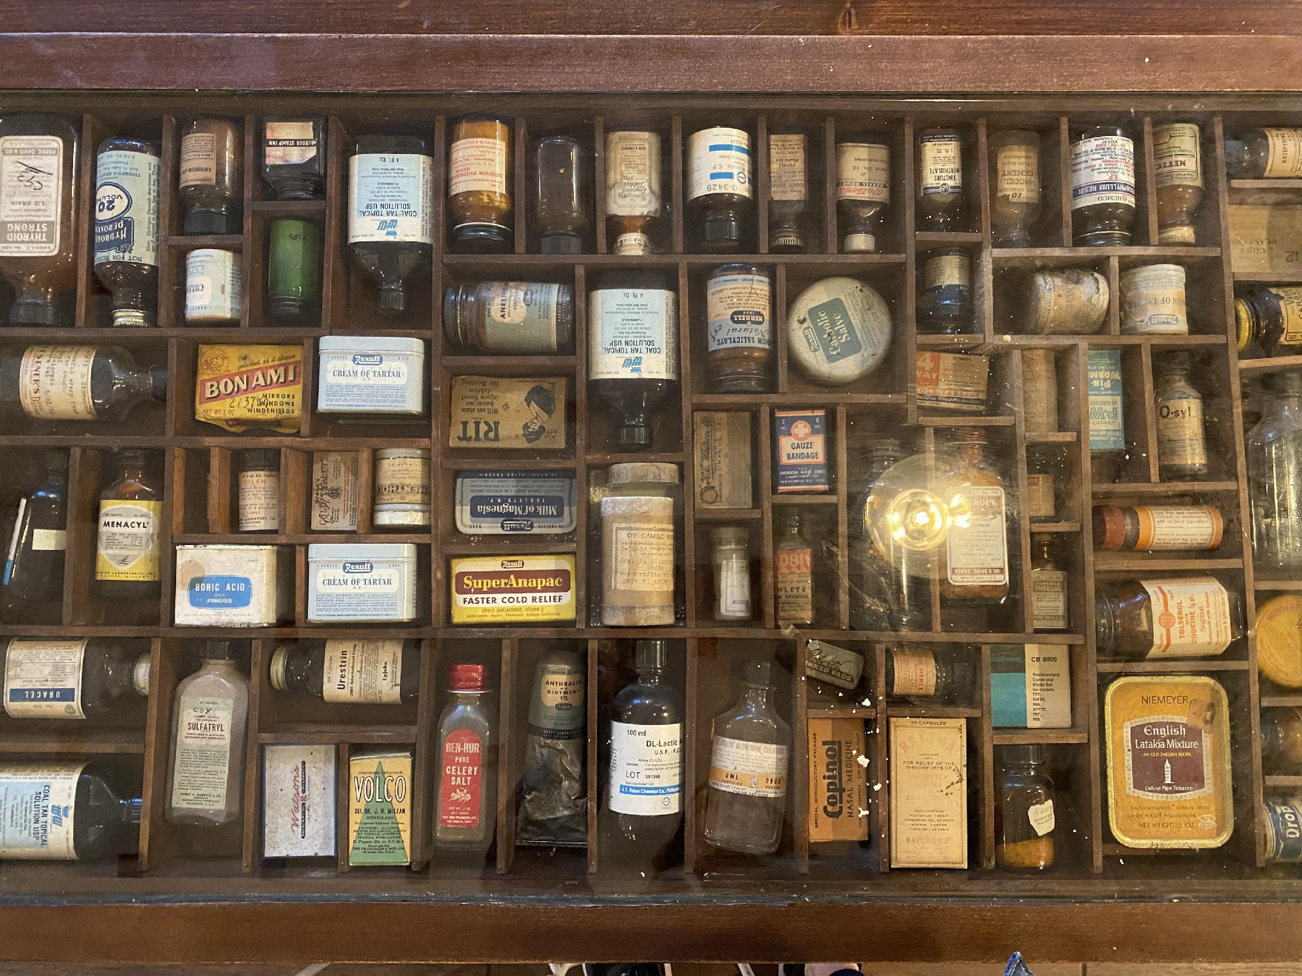
IH Challenges in Pharma
Introduction
Business Drivers
IH Challenges
Other Standards/Guidance Documents
Notes:
First job: aerospace industry.
Background in tox, interest in health care, pharma would be interesting
Entered in 1989, entry level IH at a pharmaceutical company in Palo Alto, CA.
Exciting time, growing company
Research, Development and Production facilities onsite.
Leader in development of oral contraceptives & other steroid compounds.
Several new products brought to market.
Today I’m going to give you an overview of business drivers and industrial hygiene challenges in the pharmaceutical industry. My learnings have evolved over time amidst my roles as a site industrial hygienist and radiation safety officer, and now as a consultant. I’ve learned that proactive collaboration is key to successful EH&S programs. Management’s mindset needs to incorporate EH&S aspects into the business to add value and minimize disruptions. Our efforts at being proactive are often challenged by the business drivers to move forward quickly.
______________________________
My first job out of school was in the aerospace industry. With a background in toxicology and a strong interest in health care, I thought the pharmaceutical industry would be an interesting area in which to work. I entered the pharma industry in 1989 when I got a job as an entry level industrial hygienist at a pharmaceutical company in Palo Alto, CA. This was an exciting time at a growing company with Research, Development and Production facilities.
My company was known as a leader in the development of oral contraceptives and other steroid compounds. Several new products were brought to market during my time there. Many of these products contain potent active ingredients, which we refer to collectively as potent or highly potent compounds. While these medications provide a desired therapeutic effect for patients, we can’t have employees being exposed to them above safe levels.
Today I’m going to give you an overview of business drivers, EH&S integration and industrial hygiene challenges in the pharmaceutical industry. My learnings have evolved over time amidst my roles as a site industrial hygienist and radiation safety officer, and now as a consultant. I’ve learned that proactive collaboration is key to successful EH&S programs. Management’s mindset needs to incorporate EH&S aspects into the business to add value and minimize disruptions. Our efforts at being proactive are often challenged by the business drivers to move forward quickly.

Slide 5

Working with Pharmaceutical Substances has Caused Occupational Illness
Notes:
Part of products, make sick people well or otherwise improve their lives.
NOT make well people sick
An overarching challenge in this industry is that working with pharmaceutical substances can, and has caused, occupational illness. This was the backdrop when I first entered pharma. Occupational illness had occurred at my site.

Slide 6

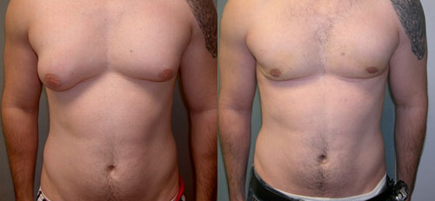

Potential of Pharmaceutical Substances to Cause Occupational Illness
Historical Examples
Sex hormones
Opiates
Antibiotics
“Cytotoxic” drugs
Prostaglandins
Source: https://commons.wikimedia.org/wiki/File:Asymmetric_Gynecomastia.jpg
Notes:
Steroid sex hormones: potential adverse health effects early on, especially men --female hormones.
Gynecomastia: enlargement of breast tissue.
Galactorrhea: discharge of fluid from breasts.
Serious condition clinically 3 stages.
If Stage 3, irreversible. Treatment: surgery. Mastectomies historically.
Occurred where I worked.
Maintenance worker cleaned the packaging lines: steroids.
Staff shortages over a few months. Wiped with alcohol. No gloves, per SOP.
Gynecomastia resulted. Surgery to correct.
At the time I began working at this site, all workers in Production having monthly breast checks.
_____________________________________________________
Steroid sex hormones were found to have the potential to cause adverse health effects early on, especially in men exposed to female hormones. The health effect is called gynecomastia, which is the enlargement of breast tissue. This can be accompanied by galactorrhea, the discharge of fluid from breasts. This is serious condition that is seen clinically in three different stages. If exposure continues and the employee advances to Stage 3, the condition becomes irreversible. The only treatment for this is surgery. There have been mastectomies historically. This occurred at the facility where I worked. A Maintenance worker cleaned the packaging lines where steroids had been processed. There were staff shortages and this worker ended up cleaning the lines over several months. He wiped surfaces with alcohol. However, the operator did not wear protective gloves, as required by the standard operating procedure. Gynecomastia resulted and the worker did have surgery to correct it. At the time I began working at this site, all workers in the Production area were having monthly breast checks to confirm that we did not have additional issues.

Slide 7
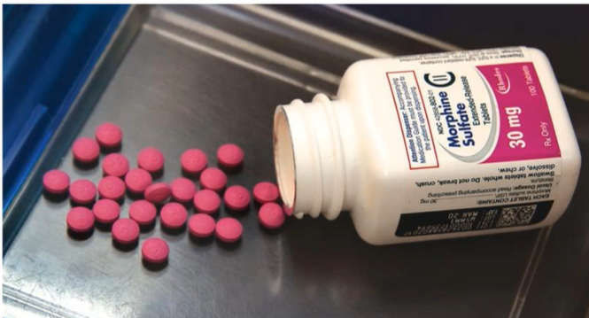
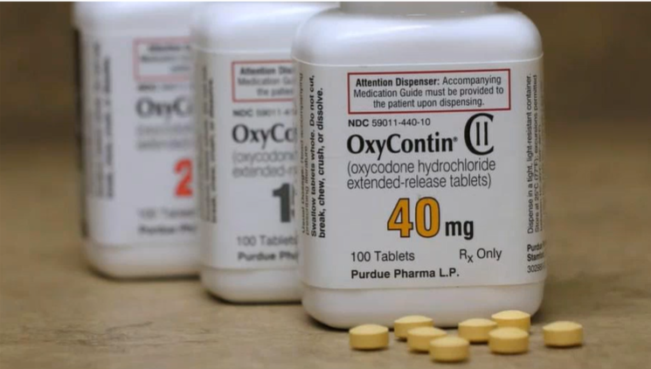
Potential of Pharmaceutical Substances to Cause Occupational Illness
Historical Examples
Sex hormones
Opiates
Notes:
Other compounds: opiates, such as morphine and oxycodone.
Treat pain, also used illicitly.
Workers are overexposed: CNS effects.

Slide 8

Potential of Pharmaceutical Substances to Cause Occupational Illness
Historical Examples
Sex hormones
Opiates
Notes:
Opiates: dermal and respiratory sensitizers.
__________________________________
This could result in us sending workers home looking something like this. Or, they may experience health effects on the job as well. Neither of these scenarios is acceptable. Opiates are also dermal and respiratory sensitizers.

Slide 9
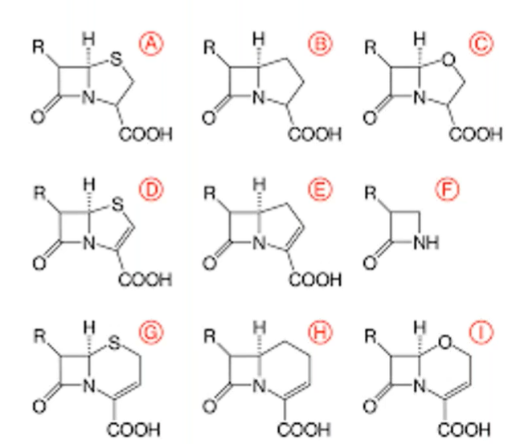
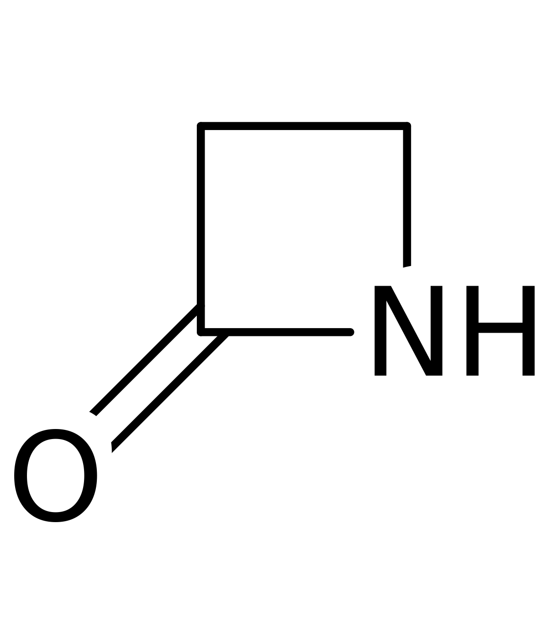
Potential of Pharmaceutical Substances to Cause Occupational Illness
Historical Examples
Sex hormones
Opiates
Antibiotics
Notes:
Antibiotics: many sensitizers.
Penicillins, cephalosporins: beta lactam rings --sensitizers.
Occupational toxicologists needed!
______________________________________________________________
This brings us to antibiotics, many of which are also sensitizers. Penicillins and cephalosporins, with characteristic beta lactam rings shown here are notorious sensitizers.
Occupational toxicologists are needed to assess potential hazards of these compounds.

Slide 10
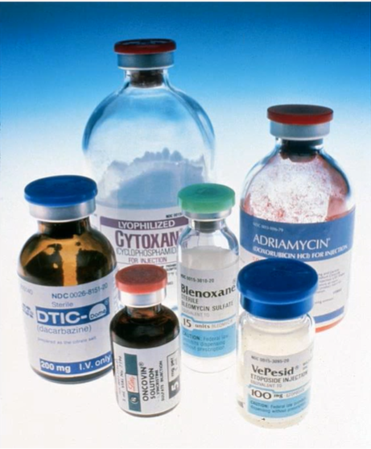
Potential of Pharmaceutical Substances to Cause Occupational Illness
Historical Examples
Sex hormones
Opiates
Antibiotics
“Cytotoxic” Drugs
Notes:
“Cytotoxic” drugs: traditional anticancer drugs --kill all cells.
Not for normal, healthy cells.
Challenge: eliminate or minimize exposure. Yet, occupational illnesses have occurred at all steps…
______________________________________
“Cytotoxic” drugs refer to our traditional anticancer drugs which kill all cells that they contact. This is good for contact with cancer cells, but not for normal, healthy cells. And we certainly don’t want workers exposed to them.
Our challenge is to eliminate or minimize exposure to potent compounds. Yet, occupational illnesses have occurred at all steps in the process, from lab-scale to pilot plant to manufacturing-scale operations.

Slide 11
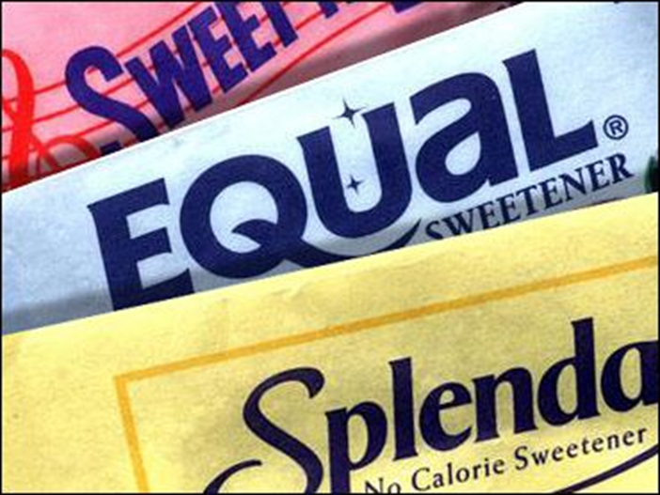
Potency of Active Pharmaceutical Ingredients (APIs)
If one packet of artificial sweetener (1 g) was ethinyl estradiol, how many birth control pills would that make?
  5
  50
  500
  5,000
  50,000
Notes:
To help you conceptualize how potent these compounds are, here is a quiz question.

Slide 12
Potency of Active Pharmaceutical Ingredients (APIs)
If one packet of artificial sweetener (1 g) was ethinyl estradiol, how many birth control pills would that make?
  5
  50
  500
  5,000
  50,000
  That is a 10 year supply for 18 women!

Slide 13
Business Drivers
  The Drug Development Process
  Toxicology and IH integration
  Antibody Drug Conjugates
  Facility Design and Lab Equipment
Notes:
I’ll now discuss Business Drivers. First, it’s important to understand the Drug Development Process as an industrial hygienist to understand how aspects of EH&S fit into the process.

Slide 14
The Drug Development Process
Innovation
  Entrepreneurial spirit
  Groundbreaking science
Speed to Market
  First to market!
  Patent protection
Funding
Big pharma versus start-ups, CMOs, CROs
  Small companies dependent upon VC input
  Develop a pipeline of products
Notes:
Groundbreaking science and innovation!
Pressure first to patent. A long road.
Pipeline
Affects EH&S staffing levels.
Small start ups may not invest in EH&S
Reactionary environments for EH&S.
_____________________________________________
We have groundbreaking science and innovation in this industry. There is pressure to be first to market and get a drug patented. This is a long road. A pipeline of products is needed to maintain a business. This affects staffing levels for EH&S programs. Smaller start ups may not invest in full time EH&S staff, so they will either give this “hat” to a scientist or hire a part time consultant. These tend to be reactionary environments for EH&S professionals.

Slide 15

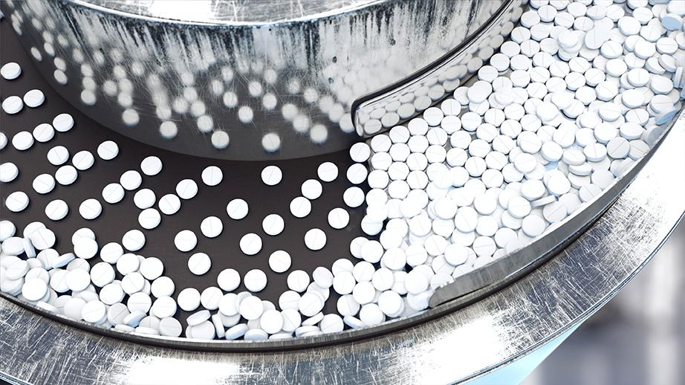
Examples of Submission Timelines & Documentation
Dilantin - 27 pages
  Discovered in 1936
  Marketed in 1938
Lipitor - 84,400 pages
  Program initiated in 1/83
  Compound identified in 1/89
  Approved → 11/96 (fast track)
Notes:
Timelines & length of submissions longer over time.
Lipitor: fast track in just over 13 years, over 84,000 pages submitted to FDA.

Slide 16
Drug Development Process
IND Submitted
NDA Submitted
Approval
Drug Discovery
Pre-Clinical
Clinical Trials
FDA Review
Phase I
20-100
volunteers
Phase III
1,000-5,000
volunteers
10,000
250
5
1
Phase II
100-500
volunteers
6.5 yrs
6 yrs
1.5 yrs
Source: based on PhRMA Profile Pharmaceutical Industry 2010
Notes:
Approval process: about 14 years.
Patents expire after 20 years.
Race to get the benefit of a patent before time runs out. Businesses look for ways to reduce that timeframe.

Slide 17
Regulatory Requirements (U.S.)
OSHA - Limited
  Technical Manual - Controlling Occupational Exposure to Hazardous Drugs
  Few specific Permissible Exposure Limits (PELs)
  In compliance cases, have applied “general duty” clause
  Globally Harmonized System (GHS)
NIOSH
  Hazardous Drug Alert for healthcare workers
FDA - Limited
  Environmental Assessment (EA)
  FDA Manufacturing Guidelines (cGMP)
Notes:
Unique challenge: since products are novel medications, we must be largely self-regulated.
Few PELs for APIs.
Pharma companies develop internal Occupational Exposure Limits, or OELs, with occ toxicologists.
OSHA’s “general duty” clause: compliance cases.
NIOSH has a Hazardous Drug list for healthcare workers: no exposure limits or surface limits
I’ll discuss more detail.
___________________________________________________________________
Another unique challenge is that since our products are novel medications, we must be largely self-regulated. There are few permissible exposure limits for active pharmaceutical ingredients, or APIs. As drugs move toward development, pharmaceutical companies will develop internal Occupational Exposure Limits, or OELs, with the help of occupational toxicologists. OSHA’s “general duty” clause will apply in compliance cases. While NIOSH has a Hazardous Drug list for healthcare workers, it does not provide exposure limits or surface limits to verify that work practices are adequate. I’ll discuss this in more detail shortly.

Slide 18
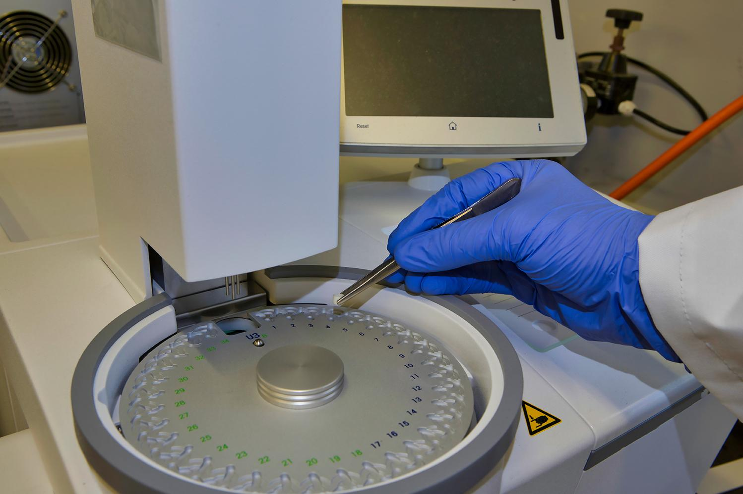
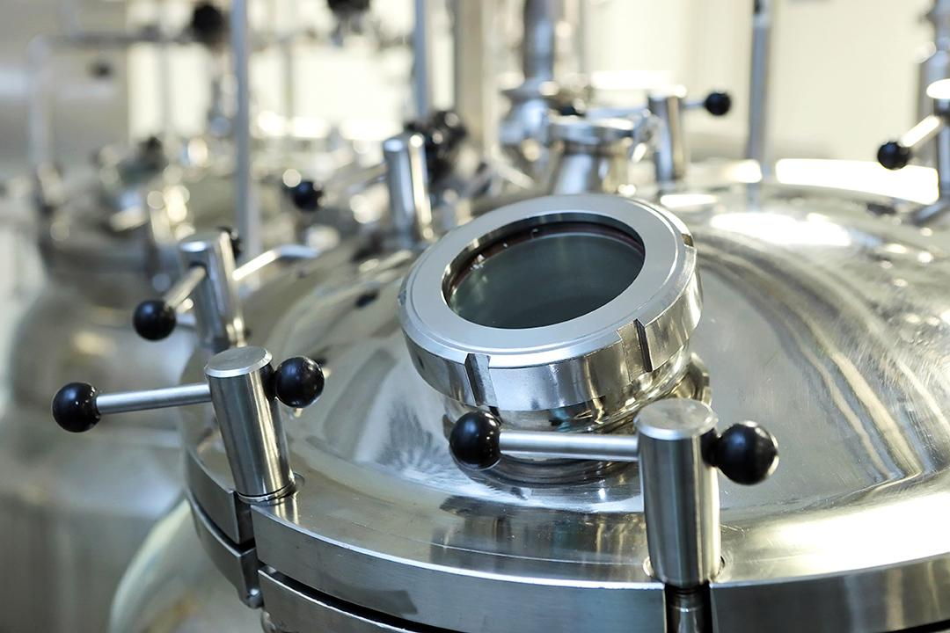
Drug Development Attrition
Compounds screened in the Discovery Phase
  10,000
Number of those that enter Pre-Clinical Phase
  250
Number of those that enter Clinical Trials
  5
Number of those that get approved
  1
Notes:
The percentage of drugs screened at the discovery phase that actually become approved drugs is on the order of 1 in 10,000.

Slide 19
Typical Drug Development Process
Drug Discovery
Pre-Clinical
Clinical Trials
FDA Review
Handle as “Default”
- or -
Follow Chemical Hygiene Plan
Generic SDS
Default or specific OHC
Handling linked to OHC
Specif. SDS
Env Tox screening
Chem & Form Dev process assessm’t
OEL
IH Method
Occ Tox testing
Process Safety eval
CMO eval
Final SDS
ASL
ADE
IH survey
Env Tox fate / fx testing
Facility Review
Safe Handling Guide
EH&S Documentation
Note: Factors (potency, volume) may shift these elements to the left or the right
Notes:
Various types
SDSs and OELs should be phase 2: start to get data.
Clinical trials beginning, much compound handling: research laboratories, pilot plant scale --initial clinical batches.
Give guidance before documentation
________________________________________________________
There are various types of EH&S documentation that should be developed at each stage of the drug development process, as noted here. Safety Data Sheets and Occupational Exposure limits should be developed in phase 2, since that’s when we start to get the data needed to develop these. By now, however, clinical trials are beginning, and there has already been much compound handling in research laboratories, even getting into pilot plant scale to make initial clinical batches. But still, we need to give guidance to users on how to handle these compounds safely before this documentation is available.

Slide 20
Integrating EH&S into Drug Development
If EH&S is poorly integrated:
EH&S develops “health and safety” programs for regulatory compliance only
Job is to “Keep the workers safe” and “Keep us out of trouble”
  Management is focused on sales and/or product development
Minimal consideration on environmental health and safety impact of the products
  Unless there is a “problem”
  If you have a “problem” the product may “die”
Notes:
“Check the box” approach
Management: reactive approach to safety.
Paradigm in many companies where business value of good EH&S integration is not understood.
_______________________________________________
If EH&S is poorly integrated, there may be a “check the box” approach for regulatory compliance only….
Management may have a reactive approach to safety. They may not want to hear about problems because the project might be killed.
This paradigm exists in many companies where the business value of good EH&S integration is not understood.

Slide 21
Integrating EH&S into Drug Development
If EH&S is well integrated:
Occupational and environmental health risks are identified
A systematic approach is implemented that
  Protects the company and workers
  Avoids delays that impact product launch
EH&S elements are incorporated into
  Product development timelines
  Facility design and construction
Product quality and EHS are both considered
Notes:
Protects reputation
Reduces product launch delays, up to $1million per day
Reduces potential for cross contamination
Challenge: influencing integration into the business.

Slide 22
Toxicology and IH Integration
Notes:
IH stronger relationship with toxicology staff in pharma
Rely heavily on our toxicology staff
Companies: product toxicology staff
Need occupational toxicologists to extrapolate data to workers.
Different challenge: workers’ typical routes of exposure: by inhalation or skin absorption.
__________________________________________________________________
Industrial hygienists need a stronger relationship with toxicology staff in pharma than in other industries. We rely heavily on our toxicology staff to give us the data we need to make sound decisions about the level of containment and control that is needed for specific projects. Companies have product toxicology staff who focus on safety of the drug product for patients. But we need occupational toxicologists to extrapolate available data to workers. This is a different challenge since typical tox testing does not apply to the workers’ typical routes of exposure, which are by inhalation or skin absorption.

Slide 23

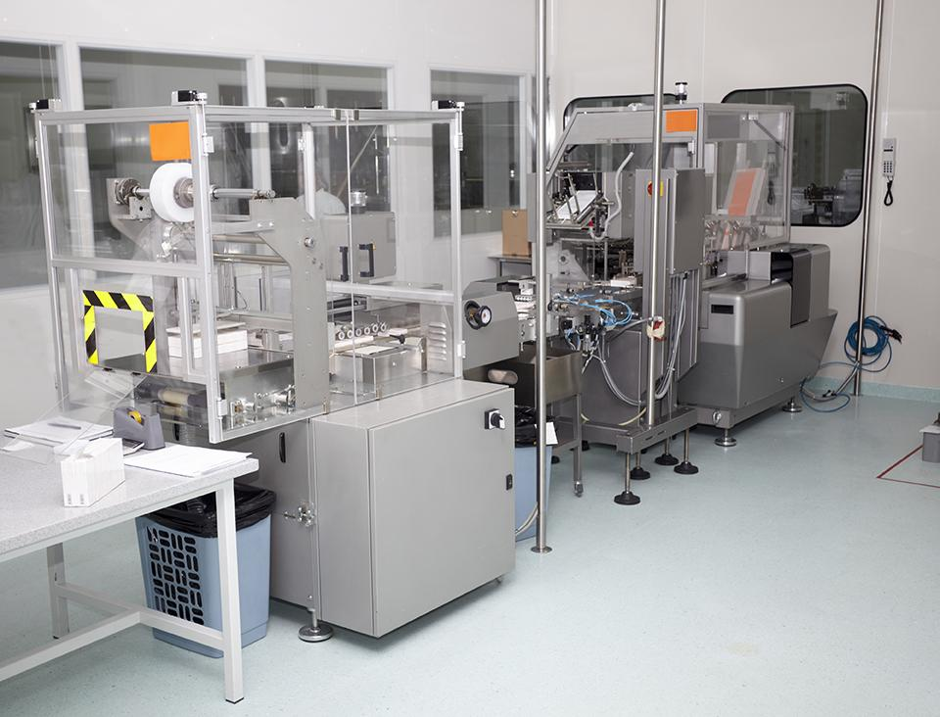
Challenges
Available toxicology info is minimal at early stages
  Default policy where no information is available
No OEL developed, so use a categorization system
No air monitoring method, so use a surrogate to simulate
Challenges with start ups
  CMOs & CROs: pressure to take projects without proper analysis
  EH&S tasked with quick tox assessments
Notes:
Lack of data: banding/categorization systems
Surrogates for monitoring
Start ups CROs) under pressure to take projects
Some EH&S personnel under pressure
Intake questionnaire at the Business Development stage.
____________________________________________
Due to the lack of data at the early stages of development, banding or categorization systems have been used for many years.
Similarly, we don’t have air monitoring methods early on, so surrogates are used for industrial hygiene monitoring.
Small contract research organizations (CROs) and contract manufacturing organizations (CMOs) are often under pressure to take on projects without a thorough analysis of toxicology and required containment to safely handle new drug entities. Some EH&S personnel are under business pressure to specify how compounds should be handled very quickly without adequate data or training to make these decisions.
We recommend use of a thorough intake questionnaire to collect known tox information from collaborators when projects are first initiated at the Business Development stage.

Slide 24
Categorization/
Banding and Handling Practice System
Groups materials by HAZARD and RISK OF EXPOSURE
Created by Pharmaceutical Safety Group (PSG) subgroup on potent compound handling
Used to communicate risks and to establish consistent control approaches
Various similar systems exist in pharma industry
Notes:
Ranges of OELs: toxicological potency & adverse health effects
Categories translate: exposure controls
___________________________________________________________________________________
Category or banding systems specify ranges of OELs based on a chemical’s toxicological potency and the adverse health effects associated with exposure.
These categories translate to exposure controls: containment through the use of engineering controls and safe handling practices.

Slide 25
SafeBridge Categories
Based on Toxicity and Potency
Category | OEL Range
1. Low Toxicity / Potency | >500 µg/m3
2. Intermediate Toxicity / Potency | 10 – 500 µg/m3
3. Potent / Toxic | 0.03 – 10 µg/m3
4. Highly Potent / Highly Toxic | ≤30 ng/m3
Notes:
SafeBridge: 4 highest potency, 1 = lowest potency.
Nanogram range: 3 and 4!
Handling practices developed for each category.
Challenge: not all companies use the same banding or categorization system.
_______________________________________________________
SafeBridge has a four-category system, as shown here. Four is the highest potency, and Category 1 is the lowest potency. We’re talking about exposure limits down in the nanogram range for categories 3 and 4!
Handling practices were developed to go along with these categories. These were developed in the 1990s in collaboration with many pharmaceutical companies who developed and shared industrial hygiene air monitoring data through the Pharmaceutical Safety Group.
A challenge here is that not all companies use the same banding or categorization system.

Slide 26
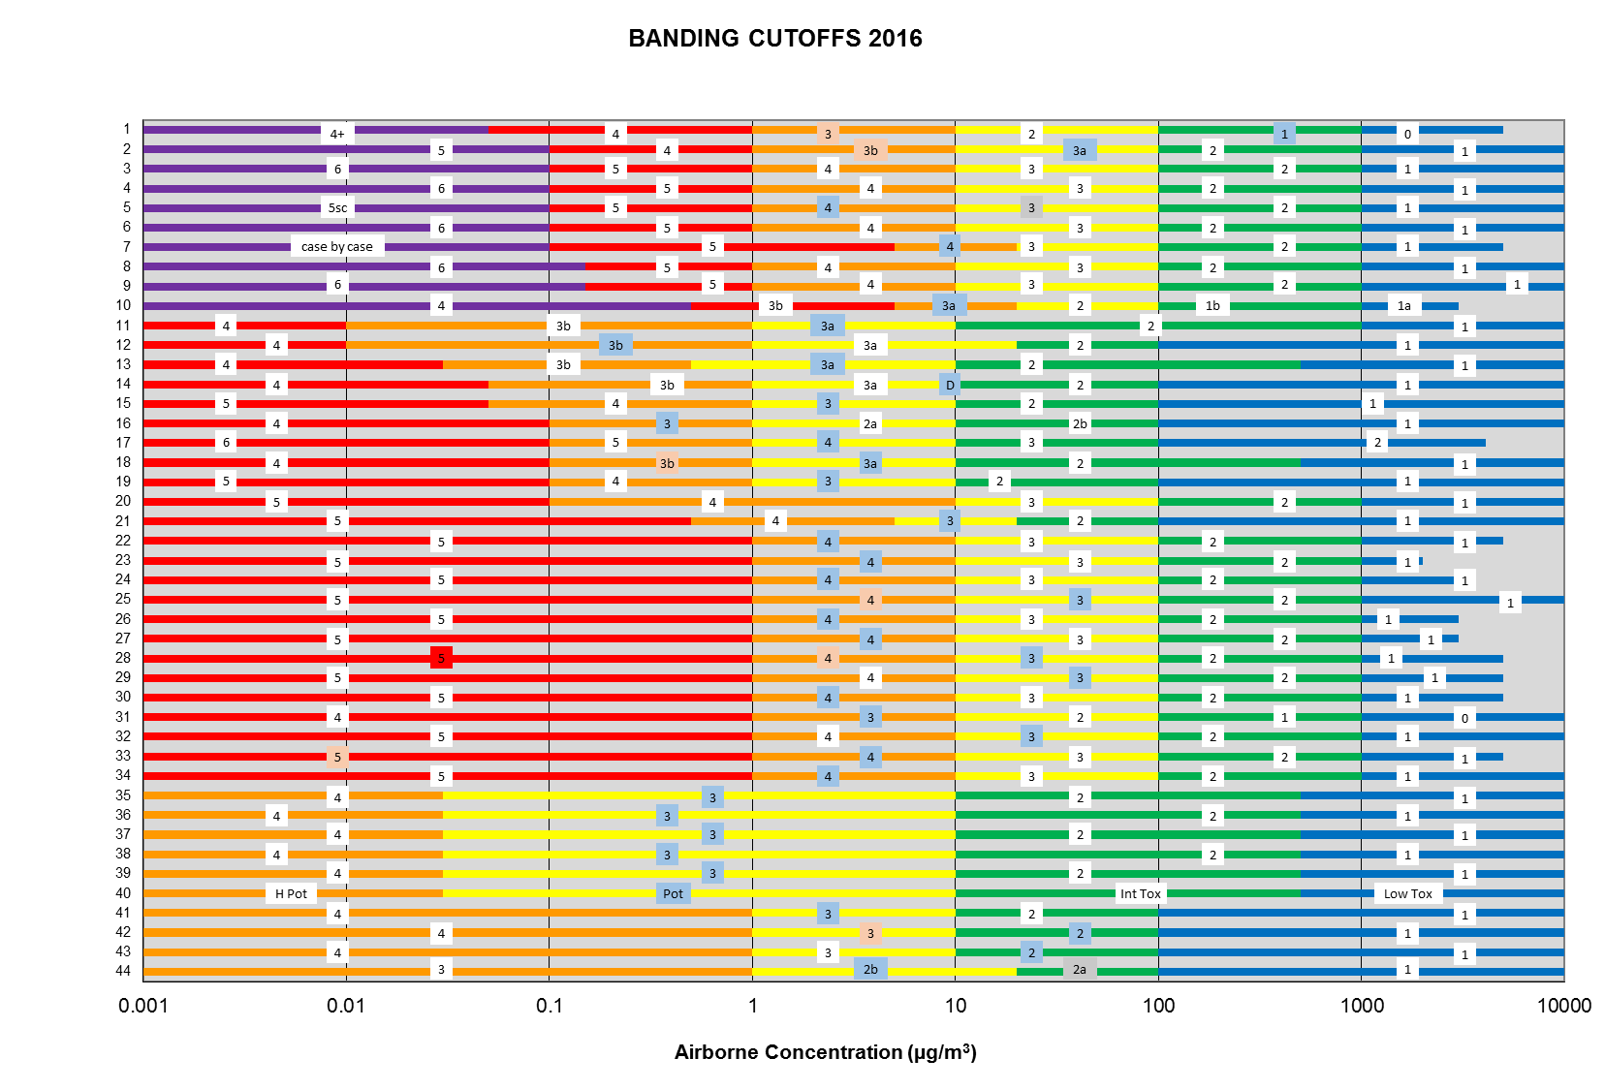
Banding Cutoffs 2016
Airborne Concentration (ug/m³)
Notes:
Number of bands differs, cutoffs too.
Company A band 3 ≠ Company B’s band 3
Business Development folks need to know!
Specify OEL ranges
May not be “apples to apples”.
_______________________________________________________________
This is an “eye chart” showing banding schemes for many different companies. The number of bands differs as well as the cutoffs. Therefore, if Company A speaks of a band 3 compound, it may not coincide with Company B’s system. Business Development folks need to be aware of this and know to ask specifics about the OEL ranges for the bands under discussion, since they may not be comparing “apples to apples”.

Slide 27
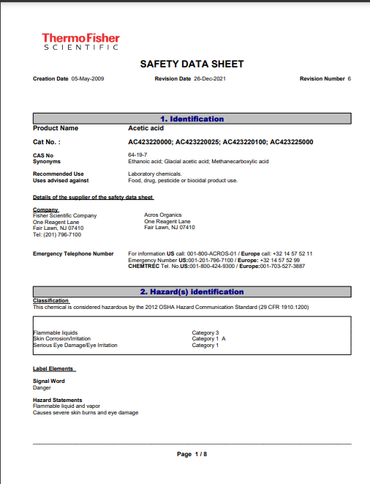
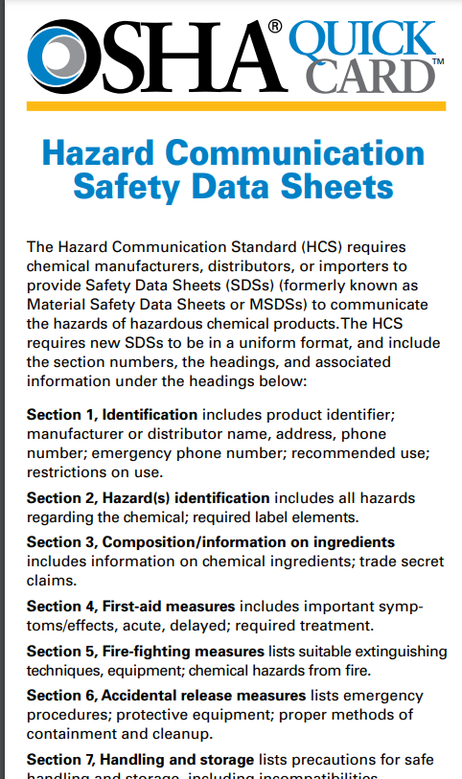

GHS versus OHC ranges
Notes:
Confusion: Safety Data Sheets
GHS does not align with pharma banding systems.
SDSs: hazard rankings in Section 2.
_______________________________________________________________
Another source of confusion is the application of Safety Data Sheets to this discussion. GHS, the Globally Harmonized System, does not align with pharma banding systems. Safety Data Sheets have hazard rankings in Section 2.

Slide 28
Banding Category vs. GHS Health Hazard Classification
GHS Health Hazard Classifications & Categories
Acute Toxicity | 1 | 2 | 3 | 4
Skin Irritation/Corrosion | 1A | 1B | 1C | 2
Most Toxic
Least Toxic
Typical Occupational Health Categories/Bands
 | 1 | 2 | 3 | 4
Potency/Effects | Low | Intermediate | Potent | Highly Potent
Examples | NSAIDs (aspirin) and antivirals | Cardiovascular drugs | Anti-cancers and steroid sex hormones | Vitamin D analogs
Least Toxic
Most Toxic
Notes:
Non-EH&S personnel often unaware: NOT same as pharma banding systems.
GHS rankings also based on 4 categories; Cat 1 MOST hazardous. Category 4 LEAST hazardous: opposite of pharma banding!
GHS requirements into effect in 2012, but pharma systems back to the 1990s.
_____________________________________________________________________
However, non-EH&S personnel are often unaware that this is NOT the same system as the pharma banding systems I just mentioned. While GHS rankings in Section 2 are also based on 4 categories, in GHS a Category 1 is the MOST hazardous, and Category 4 is the LEAST hazardous: the opposite of the pharma banding systems! The GHS requirements went into effect in 2012, but the pharma systems go back to the 1990s.
GHS-based classification the category number is inversely proportional to hazard, while OHC bands the category number is directly proportional to toxicity/hazard

Slide 29
Antibody Drug Conjugate (ADC) Components
(courtesy of BMS)
Drug/
payload/
warhead
Recognition
Element (mAb)
Linker
Tumor-specific
antigen receptor
ADC
Tumor cell
Notes:
Also in toxicology section, touch briefly on ADCs.
Exciting new therapies: treat tumor cells without off-target effects
Monoclonal antibody binds to receptor site with a linker “warhead” or “payload” attached.
Targeted approach to contacting tumor cells to kill
“D” very potent.
Maytansinoids abandoned as monotherapies because they were too toxic.
__________________________________________________________________
Also in this toxicology section, I want to touch briefly on ADCs. These are exciting new therapies in the industry designed to treat tumor cells without the off-target effects of other therapies that affect healthy cells as well as tumor cells.
A monoclonal antibody binds to the receptor site with a linker and the “warhead” or “payload” attached. This then provides a targeted approach to contacting tumor cells to kill them.
The “D”, the drug portion of ADCs, is very potent. One class of these compounds called maytansinoids were abandoned as monotherapies because they were too toxic.

Slide 30

Drug (Warhead / Payloads)
Classes of highly potent drug/warhead/payload
  Inhibitors of tubulin polymerization
    Maytansinoids (Kadcyla®), auristatins, tubulysins
  Enediynes (DNA double strand breakers)
    Calicheamicin (Mylotarg®), esperamycin
  DNA alkylating agents
    Duocarmycin, cyclopropabenzidole (CBI), pyrrolobenzodiazepines (PBDs)
Typical clinical adverse events:
  Target organ toxicity (hematopoietic system, GI tract, neurons); reproductive toxicity, embryo/fetal toxicity
    Most payloads too toxic alone – occupational implications?
Notes:
Here are some classes of warheads.
Affect DNA of tumor cells.
Too toxic alone: why targeted therapies developed.
________________________________
Here are some classes of warheads. They affect the DNA of tumor cells. They are mostly too toxic alone which is why the targeted therapies were developed.

Slide 31

Payloads Used in ADCs in Development*
Payload | # of Molecules | % Molecules
Auristatins | 24 | 42%
Maytansinoids | 12 | 21%
Calicheamycin | 2 | 3%
Duocarmycin | 2 | 3%
PBDs | 6 | 11%
Not Disclosed | 5 | 9%
Others | 6 | 11%
Total | 57 | 100%
*From World ADC Summit 2016
Notes:
This is data on the types of ADCs in development, from 2016.

Slide 32
Developing and Maintaining Safe Working Environments in ADC Facilities
ADCs are biopharmaceutical substances, the components of which are hazardous, some of which are highly potent substances
The principles used in the systematic and scientific approach to pharmaceutical occupational health and safety can be applied directly to ADCs
Notes:
Initial concerns: ability to control exposures, but successful.
Now 10-11 ADCs commercially available.
Same principles of containment as other potent compounds.
_____________________________________________
We initially had concerns about being able to adequately control exposures to these compounds, but we have been able to do so. There are now 10-11 ADCs commercially available.
The same principles of containment apply here as with other potent compounds.

Slide 33
ADC Hazard Determination
Qualitative and/or quantitative assessment required for:
  Antibody (mAb)
  Linker
  Drug (warhead/payload)
  Drug-linker
  Antibody-drug conjugate
Notes:
Occupationally: consider all aspects of ADC.
May be individually handled, or all in same area.
___________________________________________________________
Occupationally, we need to consider all aspects of the ADC. These may be individually handled, or all handled in the same area.

Slide 34
Occupational Potency and Toxicity of Biologicals and Antibodies
Originally thought to be reasonably safe to handle large molecules
  Dermal = poor
  Ingestion = poor
  Inhalation ??
  Injection ?? (Needlestick?) Cuts from glassware??
Target organ toxicity
Sensitization potential
Notes:
Monoclonal antibodies: very large molecules.
Previously anything with mw > 2000 doesn’t get absorbed into body.
Many years later, not always the case.
Questions effects on the lung & sensitization potential.
Due to large size, inhalation potential may be reduced depending on handling practices.
_____________________________________________________________
Monoclonal antibodies are very large molecules. It was previously assumed that anything with a mw larger than 2000 doesn’t get absorbed into the body. Many years later, we know that this is not always the case. There is also a question about effects on the lung and sensitization potential.
Due to the large size of these materials, however, inhalation potential may be reduced depending on handling practices.

Slide 35
Linkers
Linker is important for the stability of the ADC
  Stable until internalized in cell
  When releases drug – may cause non-specific toxicity
  Cleavable linker
    Hydrazone linkers (low pH)
    Hindered disulfides (reduced inside the cell)
    Peptide linkers (lysosomal proteases)
  Non-cleavable linker
    Thioether (protein catabolism in lysosome)
What is occupational hazard of linker v. drug-linker complex?
Notes:
Various types of linkers.
Hazards not well known.
Drug-linker complex most frequently handled.
____________________________________________
There are various types of linkers. Hazards of these compounds are not very well known. The drug-linker complex is what is most frequently handled.

Slide 36
ADC OHC Hazard Assessment
Drug moiety
    Typically highly potent
    Usually Category 4 of 4
ADC
    Generally less toxic/potent than the drug moiety
    Often still considered a potent drug (Category 3 of 4)
Need to consider antibody mechanism
Because of unique and high toxicity of the drug, occupational health categorization is not sufficient
  Quantitative risk assessments needed – OEL, ASL
Notes:
Hazard assessment incorporates which parts of the ADC are being handled,
Drug only,
Drug-linker combo, or
Full ADC with monoclonal antibody.

Slide 37
Examples of OELs
Drug/Material OEL
Naproxen (NSAID) 5,000 μg/m³
Nicardipine (cardiac drug) 400 μg/m³
Cyclosporin A (transplant rejection) 20 μg/m³
Ganciclovir (genotoxic antiviral) 5 μg/m³
Paclitaxel (genotoxic anticancer) 0.800 μg/m³
Thalidomide 0.250 μg/m³
Tamoxifen (genotoxic anticancer) 0.200 μg/m³
Cisplatin (genotoxic anticancer) 0.050 μg/m³
Ethinyl estradiol (estrogen) 0.035 μg/m³
Campothecin (genotoxic anticancer) 0.030 μg/m³
Nafarelin (peptide hormone) 0.001 μg/m³
mAbs
ADCs
Payloads
Notes:
Table with examples of OELs.
Overlay of how the mAbs, ADCs and payloads compare with other typical compounds.
The mAbs typically in liquid form; makes easier to control.
ADCs tend: Category 3 range.
Payloads highly potent range.
OELs or categories matched with handling practices
Systems to be sealed and leakproof to contain at source.
Skin contact to be eliminated.
Isolation technology typically used with warheads.
_________________________________________________________
Here is a table with examples of OELs. You can see the overlay of how the mAbs, ADCs and payloads compare with other typical compounds. The mAbs are typically in liquid form, which makes them easier to control. The ADCs tend to be in our Category 3 range. Then there are the payloads, which are in the highly potent range. The compound OELs or categories are matched with handling practices that are required to provide adequate protection. Systems need to be sealed and leakproof to contain material at the source, and skin contact with material is to be eliminated. Isolation technology is typically used with the warheads.

Slide 38
ADC Safety Uncertainties
How tightly bound is the payload to the antibody (Ab)?
Can the ADC release the payload at other unintended targets?
  What other conditions might cause the payload to be released?
  How specific is the Ab to the tumor cell?
How much free payload (not linked to the Ab) exists in the formulation?
Could the Ab be a sensitizer?
What is the toxicity of the linker? What is the toxicity of the drug-linker complex?
Could there be a local effect in the lung?
Unknown variables that affect hazard potential
Notes:
There are safety uncertainties which need to be evaluated, as you see here.
Input of an occupational toxicologist is critical.

Slide 39
IH Challenges
Business Interruptions
Speed to Market
EH&S Mindset

Slide 40

IH Challenges
Business Interruption!
October 17, 1989
The Battle of the Bay: World Series game #3
From https://commons.wikimedia.org/wiki/File:Oakland-Alameda_County_Coliseum_-_Interior_2_2017-07-31.jpg
Notes:
Establish proactive programs
Business interruptions
I’ve encountered many, will highlight just a couple here.
October 17th, 1989…
World Series game #3 between the Oakland A’s and the SF Giants was going on…
_____________________________________________________________________________________
We aim to establish proactive programs so that we’re not in firefighting mode. However, business interruptions are a reality, and we seek to also learn from these events. I’ve encountered many business interruptions, and will highlight just a couple here for illustration purposes.
On October 17th, 1989, just a few months after I had joined the pharma industry, World Series game #3 between the Oakland A’s and the SF Giants “Battle of the Bay” was going on…

Slide 41
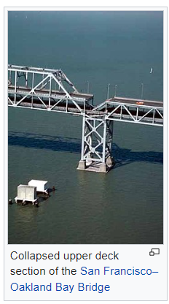
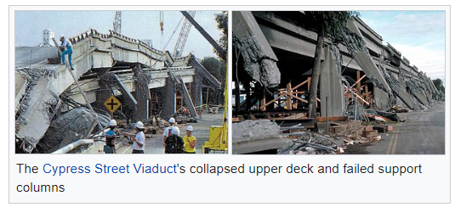
1989
Loma Prieta Earthquake
7.0
https://www.youtube.com/watch?v=Z8ExMR0c0aM
https://www.youtube.com/watch?v=d0oGabvC4Pw
Photos from Wikipedia
Notes:
7.0 earthquake at 5:04 pm.
Damage to Cypress structure and a section of the upper deck of the San Francisco-Oakland Bay Bridge.
Good thing: few people onsite
__________________________________________________
A 7.0 earthquake occurred at 5:04 pm. There was damage to the Cypress structure and a section of the upper deck of the San Francisco-Oakland Bay Bridge, shown here.
The good thing from an occupational standpoint is that very few people were onsite this day since it was after 5 pm and many had left early to watch the playoff game.

Slide 42
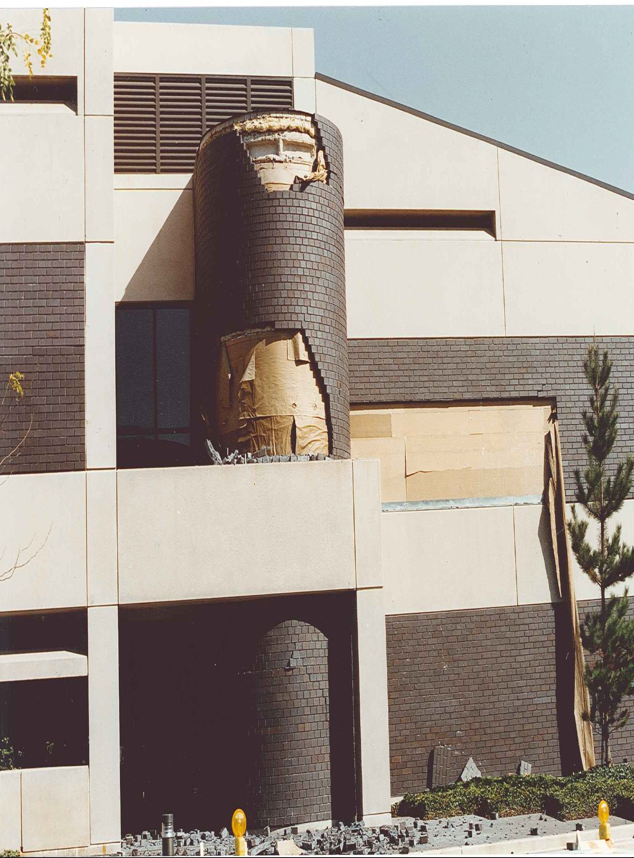
Loma Prieta Earthquake
October 17, 1989
Notes:
However, there was significant damage on our site. This is a picture of outside damage to one of our buildings following the quake.

Slide 43
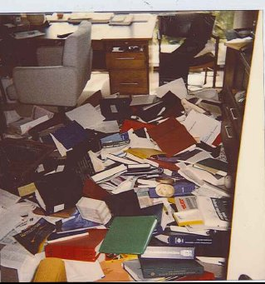
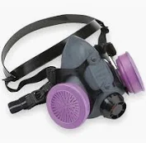
Legal Department
Asbestos
Notes:
Ceiling panels fell, including in Legal Dept.
Asbestos dislodged
Covered extensive binders legal documents
2 weeks in a 1/2-face HEPA-filtered respirator, Tyvek suit and gloves with colleagues HEPA-vacuuming binders in the Legal office area.
____________________________________
We had ceiling panels fall from above office areas, including our Legal Department. Asbestos was dislodged from above the ceiling panels, which covered the extensive binders of legal documentation, as this was before documentation was managed electronically. I spent the next two weeks in a half-face HEPA-filtered respirator, Tyvek suit and gloves with colleagues HEPA-vacuuming binders in the Legal office area.

Slide 44
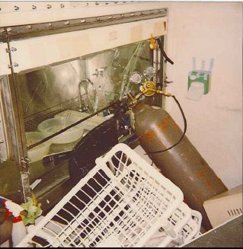
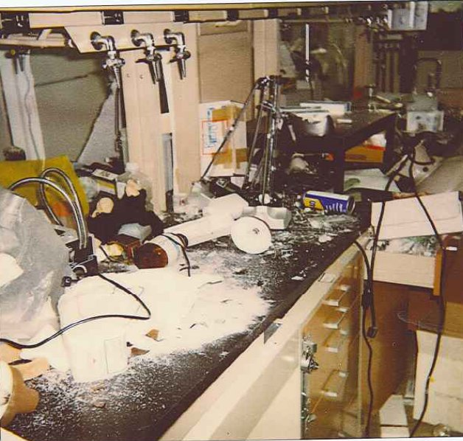
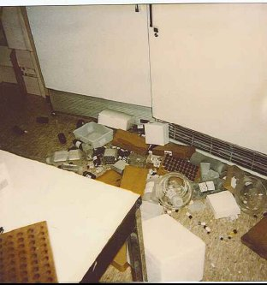
Notes:
Extensive damage in some research buildings.
Compressed gas cylinders fell, refrigerator doors opened, contents were dumped
Other chemical containers on benchtops fell and broke.
Challenging clean up effort followed.
Quake had a rolling effect; some buildings hit hard, others minimal damage.
_____________________________________________________
We also had extensive damage in some of our research buildings. Compressed gas cylinders fell, refrigerator doors opened and contents were dumped into several labs. Other chemical containers on benchtops fell and broke. A challenging clean up effort followed. This quake had a rolling effect, and some buildings were hit hard while others had minimal damage.

Slide 45
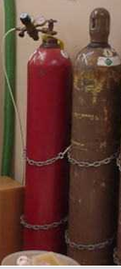
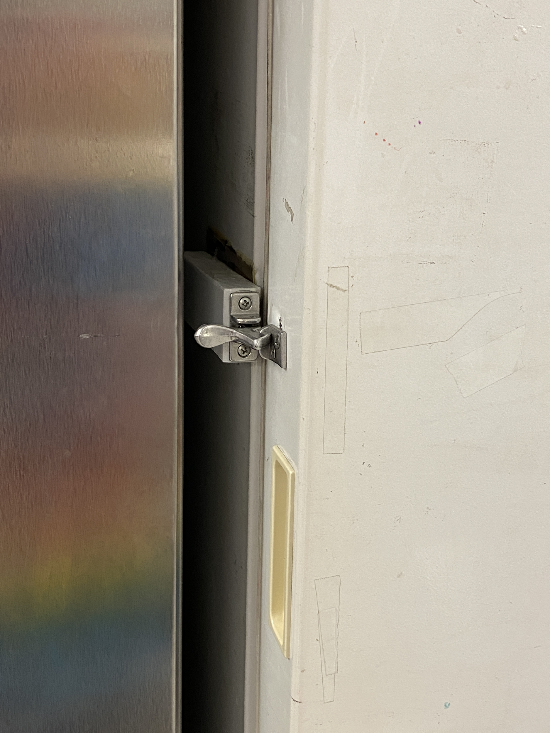
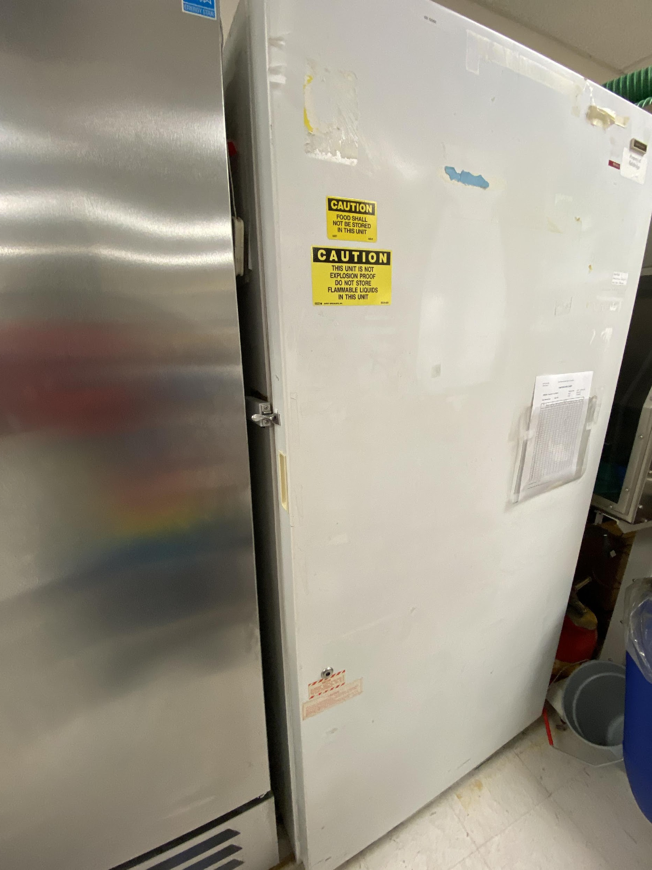
Lessons Learned/Improvements
Securing of compressed gas cylinders
Seismic bracing
Latches on Refrigerators/freezers
Notification systems
Asbestos management
ERT capabilities and resourcing
  Team expansion
  Heavy Search and Rescue
  Equipment
  Structural assessment capabilities
Notes:
We learned much from this event to reduce damage from future quakes.

Slide 46
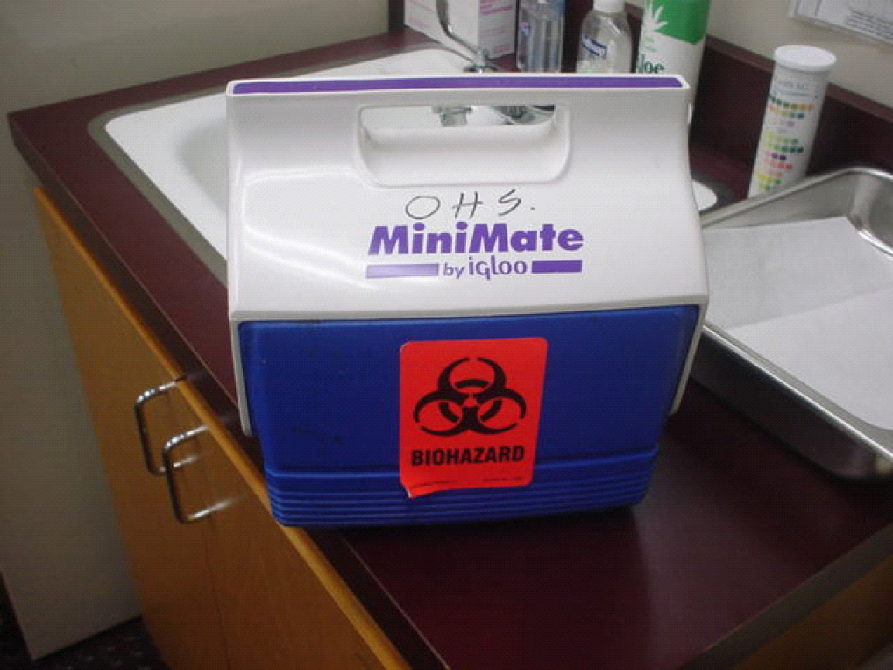
Sample Transport Between Labs
Policy: Use closed secondary containment
Notes:
Incident from past.
Policy to transport between labs in closed, secondary containment.
Good option: small, dedicated ice chest.
Did not always happen.
_______________________________________________________
Here is another incident that occurred in my past. We had a policy that researchers were to transport samples between labs within closed, secondary containment. A good option for this is a small, dedicated ice chest, as pictured here. However, this did not always happen in practice.

Slide 47


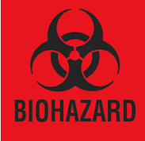
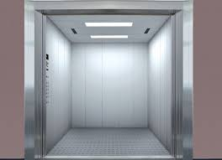

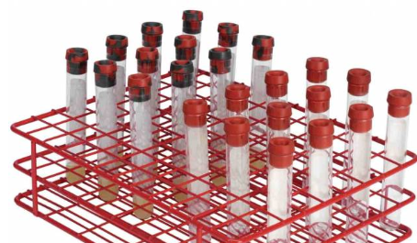
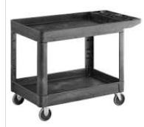
The Situation…
Notes:
Researcher moving rack of test tubes without secondary containment on cart.
Cart moved into freight elevator; fell as going over threshold.
Samples fell.
“All in one” incident
Tubes contained radiolabeled potent compounds within biological material.
Additionally, elevator shaft = confined space.
Not a true emergency.
Elevator placed out of order
Elevator company onsite
Gaff with duct tape
Test tubes had not broken or opened up
Secondary containment improved
____________________________________________________
One day, a researcher was moving samples, a rack of test tubes, without the required secondary containment on a cart. When the cart was moved into the freight elevator, it fell as it was going over the threshold. The samples fell down the crack between the floor and the elevator. This became our “all in one” incident since the tubes contained radiolabeled potent compounds within biological (biohazardous) material. Additionally, the elevator shaft was a confined space.
The good thing was that this was not a true emergency. The elevator was put out of order until the next day when we could get the elevator company onsite to make it safe to retrieve the samples. We were able to use a gaff with duct tape on it to grab the test tubes. And thankfully, the test tubes had not broken or opened up when they fell. This all resolved well but was a good point of discussion at our next Safety Committee meeting. Secondary containment improved within this department after this incident!

Slide 48
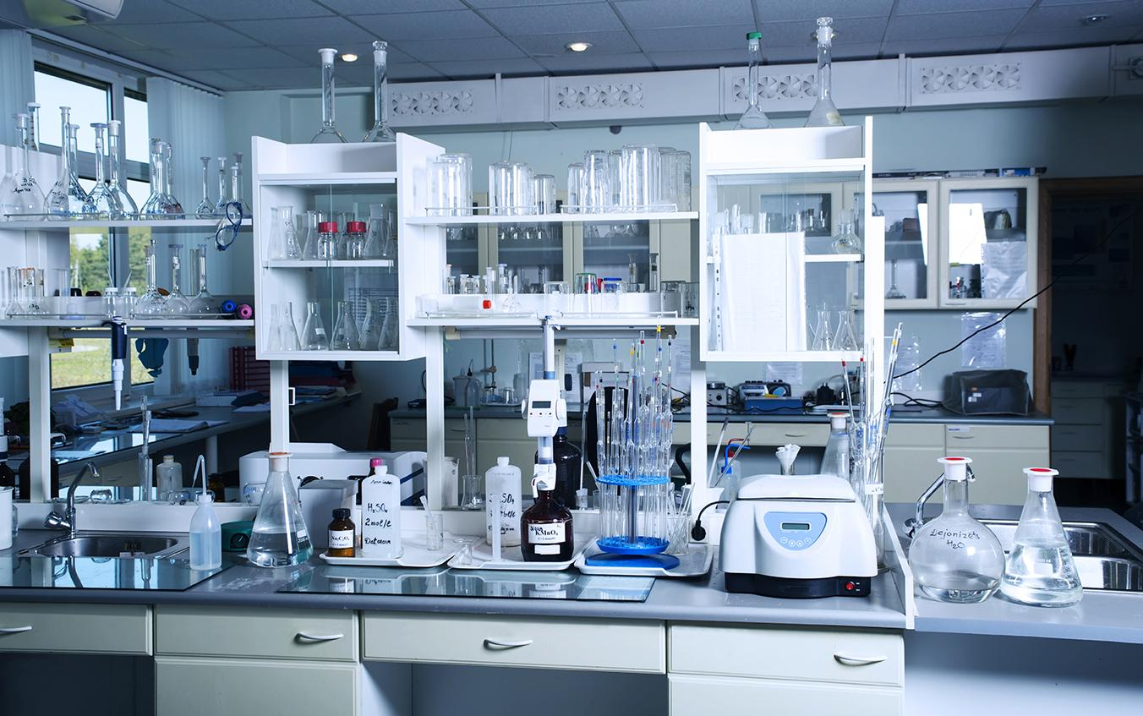
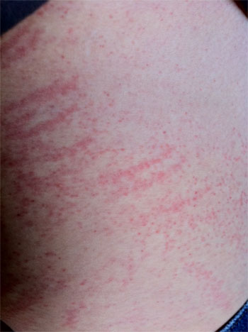
Business Mindset Toward EH&S
Myth: “If I don’t see powder, there’s not a hazard.”
  Visually clean surfaces often contaminated
Not visible, not regulated = sometimes difficult to get “buy-in” for controls
Reactive versus proactive
Cavalier attitudes
Maintenance and cleaning operations often overlooked.
Source: https://commons.wikimedia.org/wiki/File:ContactDermatitis.jpg
Notes:
Several years as a Radiation Safety Officer.
Radioactive hazards: measurable and highly regulated.
Easy to put proper controls into place.
Visible in air ~100 ug/m3
Visible on a surface ~5 ug/cm2
Don’t always need air monitoring to implement improvements
We can get data, not always most efficient
Maintenance and cleaning operations often overlooked.
Another situation; person developed rash on arms after process in Formulations Development.
Disposable coveralls and poly coated sleeve covers during cleaning.
Incident investigation: isopropyl alcohol.
Poly coated sleeve covers not resistant
Revised process: sleeve covers resistant to IPA.
_____________________________________________________
Other challenges exist around the business mindset of the companies in which we work.
I spent several years as a Radiation Safety Officer. In many ways, it was easier to manage radioactive hazards because they were measurable and highly regulated. This made it easy to put proper controls into place. However, mindsets with respect to novel drug compounds are variable. There is often an attitude that “if I don’t see powder, there is no hazard present”. But hazardous levels of potent compounds in the Category 3 and 4 ranges, and even some in Category 2, are not visible at their respective OELs.
There are researchers who are cavalier in their approach to safety compliance. Some of these people are lead scientists.
There are times when we know as industrial hygienists that engineering control improvements are needed without doing air monitoring, but sometimes the business has difficulty “buying in” to this concept without data being presented. We can get data, but this is not always the most efficient or cost-effective way to work.
Maintenance and cleaning operations are often overlooked. I referenced this earlier with the case of gynecomastia. Another situation involved a person who developed a rash on the arms after a process in Formulations Development. Disposable coveralls were worn during formulation processing and poly coated sleeve covers were added during cleaning. Upon conducting an incident investigation, we learned that the cleaning process involved use of isopropyl alcohol. The poly coated sleeve covers were not resistant to isopropyl alcohol. We revised the process to include the use of sleeve covers that were resistant to IPA.

Slide 49
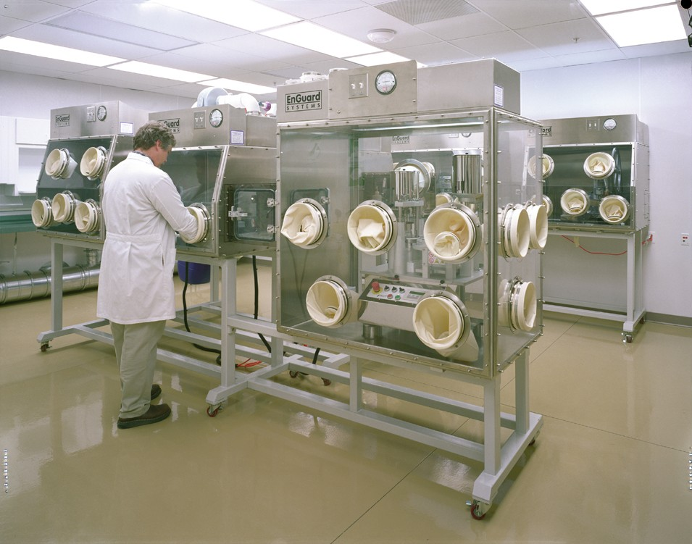
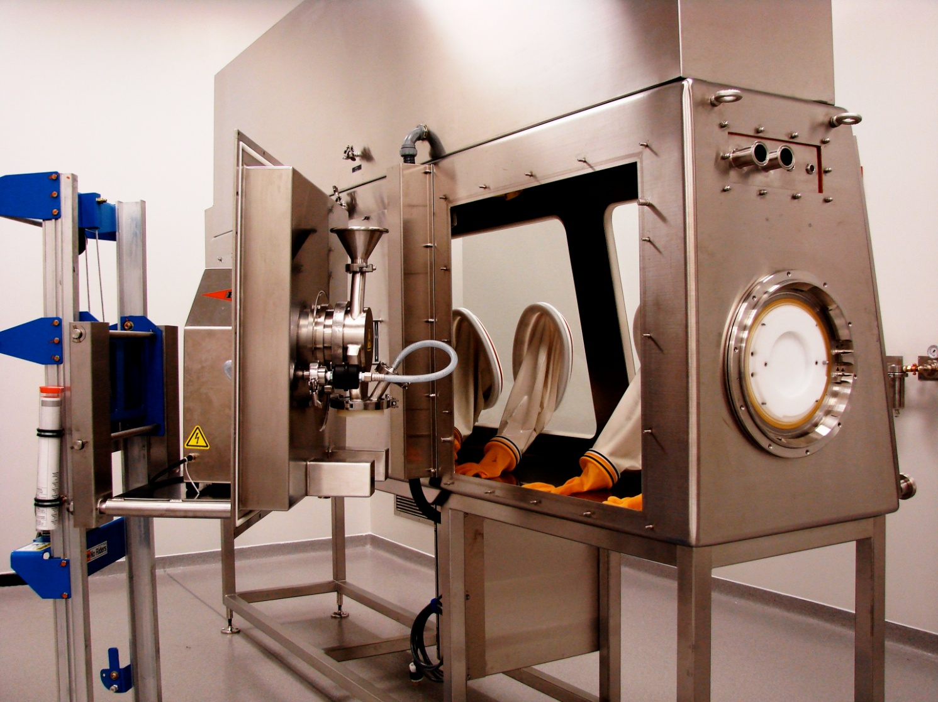
Speed to Market
Installed new controls, but proper training time not given
  Initial failure upon testing
Notes:
Tendency: cut corners.
This brings me to another important concept:
_________________________________________
I mentioned speed to market earlier. There is pressure to get equipment running quickly, including new processes. This can cause a tendency to cut corners. As an example, when a new pilot plant was installed at a site where I worked, there was a rush to get the new containment equipment up and running quickly. This included the use of new isolators. I had cautioned the team to include adequate time for the operators to gain familiarity and experience with using this equipment before we did our surrogate testing. This did not happen, and initial industrial hygiene studies failed to meet the containment target. Was this due to an issue with the equipment or the personnel? No, it was due to inadequate time to work with the new systems. Testing was redone with better results. This brings me to another important concept:

Slide 50
Humans can, and will, defeat the best engineering controls.
Notes:
Training and a good safety culture are imperative to success

Slide 51
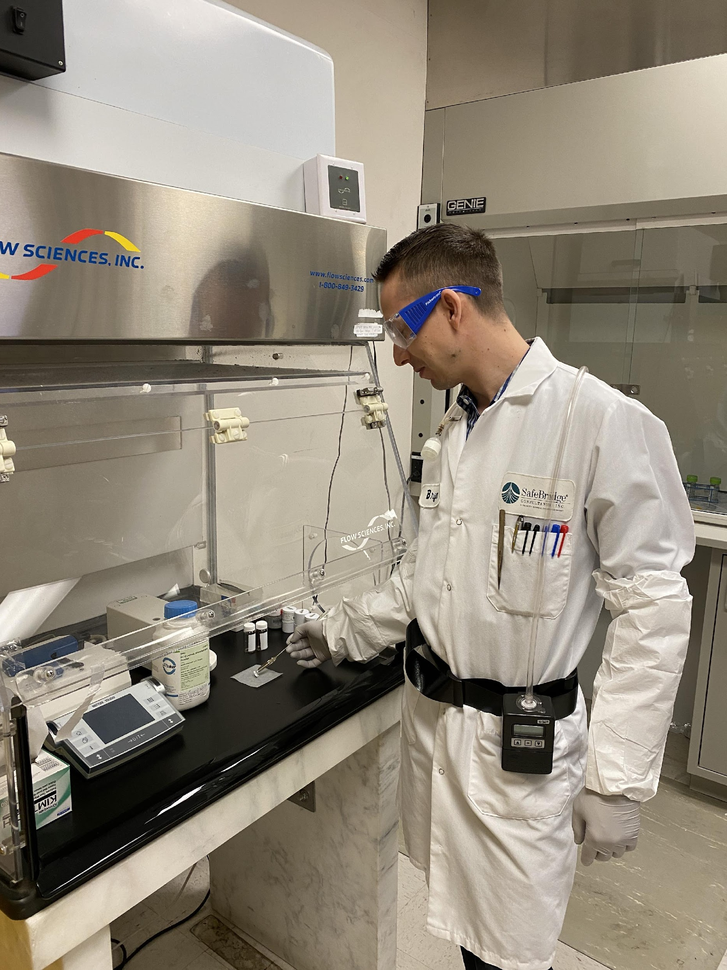
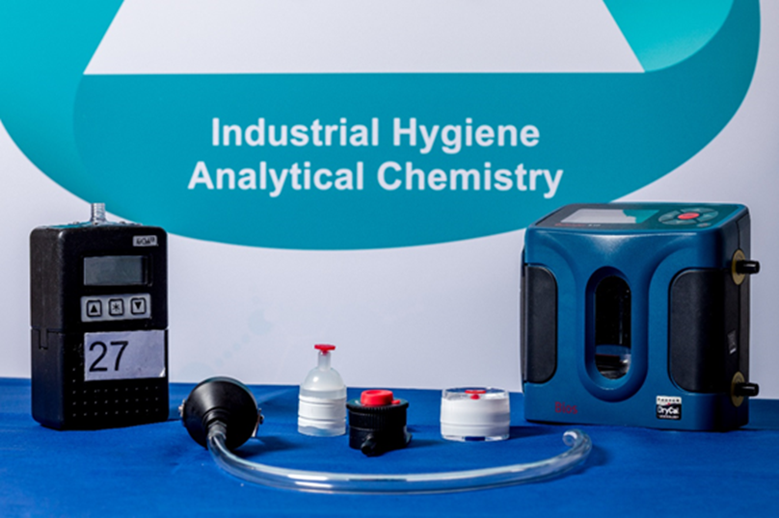
Industrial Hygiene Monitoring
Many potent drugs, often in same area
No data on combined effects from multiple compounds
Methodology
  Task samples are standard, versus 8-hour TWA.
    Compare to OEL or CPT
  Surface sampling
    Compare to ASL or default guidance
Monitoring methods: analytical sensitivity in picogram range
  Naproxen Sodium: 5 pcg/sample
  Acetaminophen: 50 pcg/sample
  Lactose, mannitol: 500 pcg/sample
Notes:
Determine where exposure points are likely to occur and contain.
Surface sampling: tracked around a facility.
____________________________________________________________________
Potent compound handling areas often deal with many different compounds. We usually do not have information on the combined effects of these compounds, should employees be exposed to them. This is one reason why best practice in potent compound industrial hygiene studies is to collect task samples as opposed to 8-hour samples. We need to determine where exposure points are likely to occur and contain them. Surface sampling is also done to understand how compounds are likely to be tracked around a facility. Acceptable Surface Levels, or ASLs, are determined by toxicology staff or alternatively, there is a default guidance which can be used.

Slide 52

Goal of EH&S: Influence Behavior
Researchers’ goal: drug to market
Notes:
Big pharma vs start-ups
Authority granted varies widely.
Some researchers are difficult to influence.
_______________________________________________
As EH&S professionals, our aim is to influence changes in behavior to affect good safety performance. We can accomplish more if we can influence teams toward proactive safety behaviors versus acting as a policeman. Big pharma tends to have better developed programs, often with corporate oversight, that can be very helpful toward achieving our EH&S goals. Start-ups, however, are “lean and mean” and may not even have a full time EH&S position. We therefore may be in a part time consulting role. The level of authority granted to us varies widely. Some researchers are difficult to influence.

Slide 53
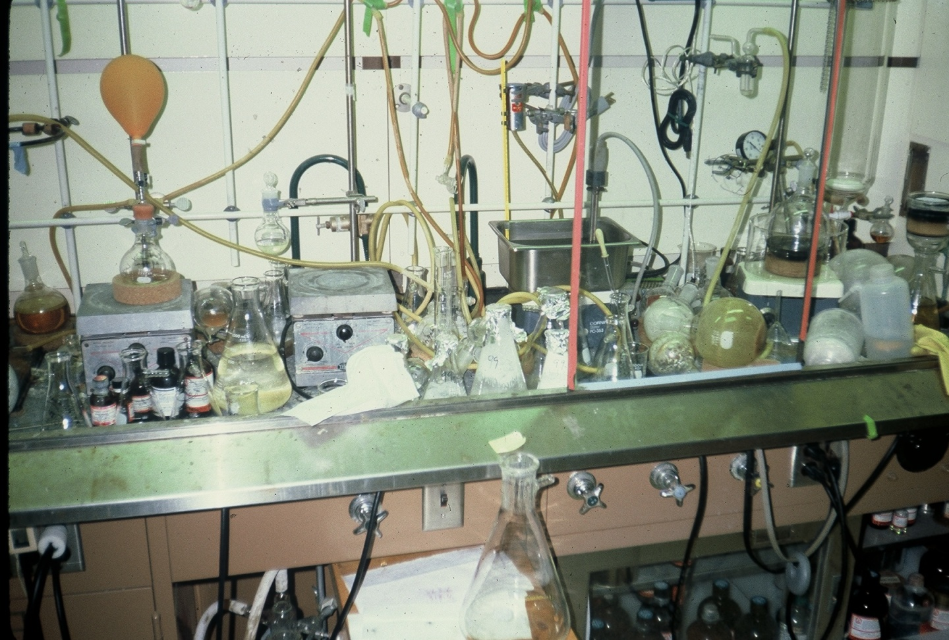
Norm’s Hood
Notes:
Norm: chemist, difficult to influence.
Group w/ others, many PhDs. A challenge.
Older equipment in pilot plant: containment challenging, higher reliance on respirators.
Improved over time, slow evolution.
Built relationships & programs to improve EH&S compliance.
Teamwork: development of leaders in department:
Championed safe behaviors & improved engineering controls.
Established safety inspections & IH monitoring programs.
Evolution of working together over 20 years
______________________________________________________
Norm was one of these chemists who was difficult to influence, and this was his hood. He was part of a group where there were others like him, many of which held PhDs. Working with this group was a challenge. Older equipment in the adjacent pilot plant made containment of scale-up reactions challenging, so there was a higher reliance on respirators.
I’m happy to report that conditions in this department improved over time, but it was a slow evolution over many years. We gradually built relationships and programs to improve the level of EH&S compliance. Teamwork resulted in development of leaders within this department who championed safe behaviors and improved engineering controls. We established safety inspections and IH monitoring programs.
Evolution of working together over 20 years

Slide 54


An Evolution
Seek first to understand, then to be understood
Move to a proactive state
  Safety inspections
  Reward positive behavior
  Encourage incident reporting
Think win-win
Notes:
The evolution: soft skills not typically taught in school.
Engage w/ researchers, understand business & challenges first.
Took years, trial error.
Developed partnership: contributors to creative solutions. (Not Norm!)
More proactive state.
Chemistry incident, reactions went wrong: lead chemist developed analyses
Win win!
_____________________________________________________________
The evolution I’ve discussed involves soft skills that are not typically taught in school. We needed to engage with these researchers and understand their business and challenges first. This took years along with trial and error along the way. We developed a partnership over time and some of them became contributors to finding creative solutions. (I have to say that Norm was not one of these folks!) We eventually got to a more proactive state. When we did have a chemistry incident where reactions went wrong, we had a lead chemist on the safety team who developed analyses of what went wrong chemically and distributed the information to all medicinal chemists for their awareness. This was a win win!
7 Habits of Highly Effective People, Stephen Covey
Be Proactive
Begin with the End in Mind
Put First Things First
Think Win-Win
Seek First to Understand Then to be Understood
Synergize

Slide 55
Collaborations
Team development of Chemical Hygiene Plan
Team customization of Potent Compound Handling Guidelines in Medicinal Chemistry
Integrated Safety Committee
  Championed by a VP of Research
  Safety Coordinators led teams in their departments
  Friendly competition
Proactive metrics
  Safety inspections
    Tracked to closure
  Evacuation drills (documented)
  Safety training attendance
  Incident reporting
Safety as a performance metric (5%)
Notes:
“Best fit”: multidisciplinary teams, scientists, operators incorporate safety into day-to-day business
Pleasure of great collaborations with scientists.
Examples of what I’ve seen that worked well.
Led by own departments: very effective.
VP chair a safety committee
______________________________________________
The “best fit” for safety and industrial hygiene is to develop multidisciplinary teams where scientists or operators incorporate safety into their day-to-day business, as opposed to EH&S serving as a police force. I’ve had the pleasure of serving on teams which resulted in great collaborations with scientists. These are some examples of what I’ve seen that worked well. Safety teams led by individuals in their own departments can be very effective.
Having a research VP chair a safety committee provides an unparalleled level of support. Of course, this is not always readily achievable.
At one site, we had a friendly competition each year where proactive metrics were tallied for each department and the winning department received a nice barbeque lunch hosted by Environmental Health and Safety. Leaders of department teams were also treated to an elegant dinner once a year with EH&S and top management to thank them for their contributions.
Having safety as a performance metric, on the order of 5% of the performance reviews, was another effective way to get all involved in supporting proper safety behaviors.

Slide 56
Facility Design and Lab Equipment (Engineering Controls)
Get EH&S involved early!
Notes:
Next, I’ll discuss some issues around engineering controls. For best results, early collaboration with engineering and other stakeholders is a key factor.

Slide 57
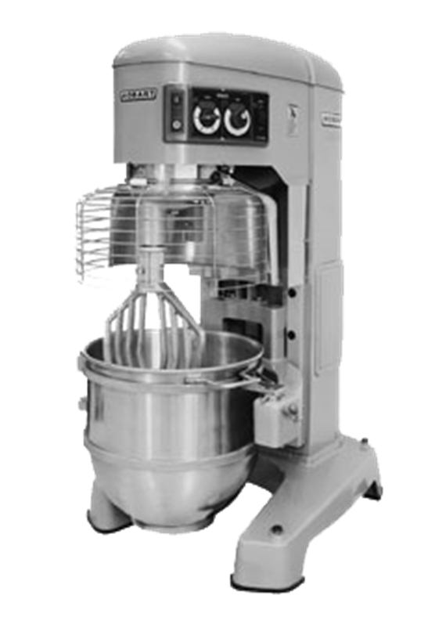
The Room Cannot Be the Containment
Use of wrong or antiquated equipment
Purchase of older facilities (CMOs, CROs)
  Conversion of office use to lab use
  Non cleanable surfaces
    Wood surfaces in labs
    Chemical storage in office cabinets
New pilot plant design did not include local exhaust ventilation
Air pressure relationships/ventilation gradients
Notes:
Early pharma technology: equipment from food industry.
Hobart 140 quart mixer, used in bakeries.
Okay for earlier, non-potent drugs, but not for today’s potent compounds!
Bigger Hobart to mix oral contraceptives.
Still used in the US.
Cannot just upgrade equipment due to FDA approval processes
TOPO granulator, Hobart mixer, Lodige
_________________________________________________________________
Much of the early pharmaceutical technology was based upon equipment from the food industry. This is a Hobart 140 quart mixer which is used in bakeries. This was okay for earlier, non-potent drugs, but not for today’s potent compounds! I encountered a bigger Hobart, with a bowl that went up to my shoulders, in a foreign country being used to mix oral contraceptives. These are still used in the US as well.
Cannot just upgrade equipment due to FDA approval processes
In potent compound handling, the room cannot be the containment. We see this in older facilities and in processes where EH&S was not integrated from the beginning. Older facilities often face this challenge.
TOPO granulator, Hobart mixer, Lodige

Slide 58
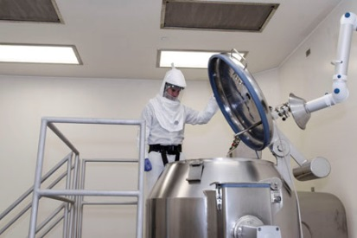
Notes:
What’s wrong with this picture?
Control at source
LEV drop ineffective in design & placement.
Many questions.
Liquids easier than powders.
Dust and aerosols in head space.
How was API charged? Contained?
LEV ineffective: potent compound dust.

Slide 59
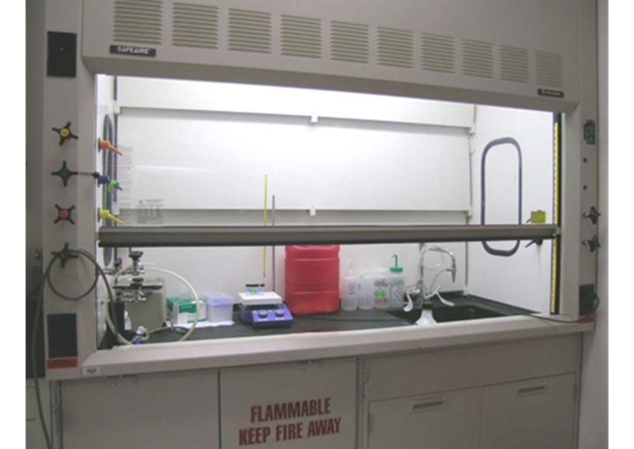
Engineering Controls
Laboratory-Type Hoods
The pictured hood is appropriate for use with potent compound powders.
  True
  False

Slide 60
Engineering Controls
Laboratory-Type Hoods
The pictured hood is appropriate for use with potent compound powders.
  True
  False

Slide 61
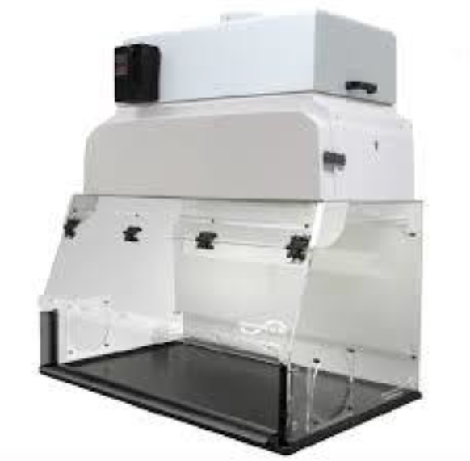


All Hoods Are Not the Same
Notes:
Common thoughts:
Similar hoods are equal.
More air = better
Not the case!
VBE on right: contain potent powders to low OEL ranges.
Laminar airflow away
Air velocity ~ of 70-80 fpm.
However, we see units such as the chemical bench or “fume” hood pictured on the left used for pharma powders.
Fume hoods NOT for powders.
Higher airflow: turbulence can enable powders to escape.
_______________________________________________
There is a common thought that similar looking hoods are the same and that more air is better. However, this is not the case here. The ventilated balance enclosure on the right is specifically designed to contain potent compound powders down to the low OEL ranges. These units have laminar airflow away from the worker. Air velocity is on the order of 70-80 fpm. However, we often see units such as the chemical bench or “fume” hood pictured on the left used for pharmaceutical powders. These units ARE NOT intended for powders. Their higher airflow can cause turbulence which enables powders to escape.

Slide 62
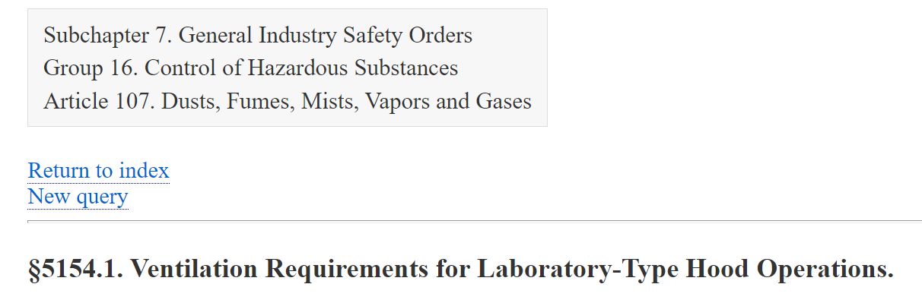
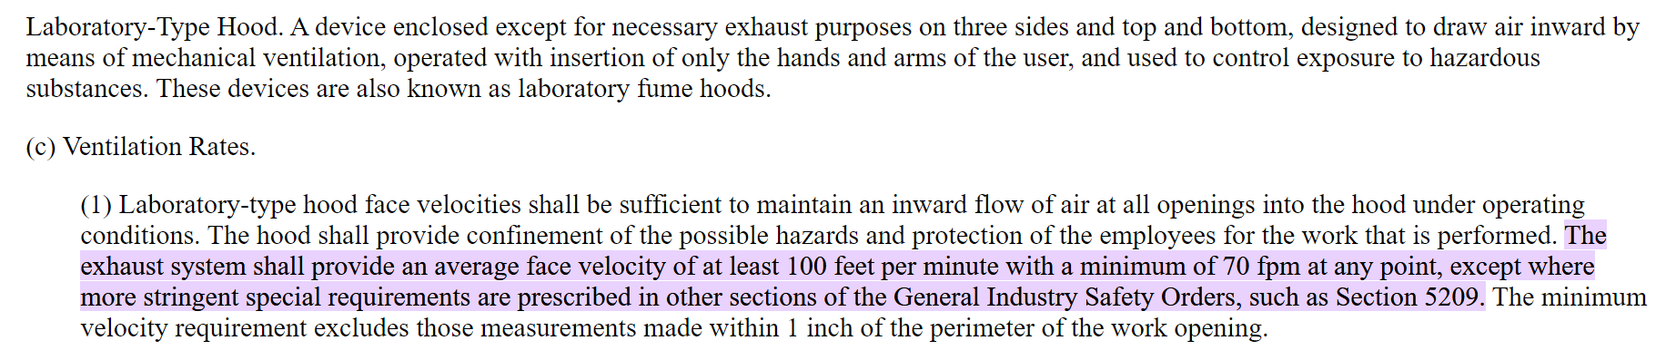
More Air is Not Necessarily Better
Notes:
Units confused.
CA reg: “laboratory-type” hood face velocities provide avg. face velocity of @ least 100 fpm.
NOT appropriate for VBEs
Installations where >100 fpm on these units
Engineers didn’t understand
IH work w/Engineering
__________________________________________
These units sometimes get confused. And there is a California specific regulation noting that “laboratory-type” hood face velocities shall provide an average face velocity of at least 100 feet per minute. This is NOT appropriate for the ventilated balance enclosures that I just showed you. Yet I have seen installations where the air velocity was turned up to past 100 fpm on these units because the engineers did not understand this difference. It’s important for the IH team to work with Engineering to put the best solutions into place.

Slide 63
Other Standards/Guidance Documents
USP 800
NIOSH Hazardous Drug Alert
AIHA Healthcare Working Group
Notes:
Finally, I want to say a few words about USP 800 and the NIOSH Hazardous Drug Alert

Slide 64
USP <800> Hazardous Drugs - Handling in Healthcare Settings
“Provides standards for safe handling of hazardous drugs to minimize the risk of exposure to healthcare personnel, patients and the environment.”
Hazardous Drugs: also known as potent compounds.
IH Expertise
Pharmaceutical IH expertise has not funneled down to the same level in healthcare setting.
USP website accessed 10.18.22
Notes:
USP 800 provides standards for safe handling of hazardous drugs IN HEALTHCARE SETTINGS to minimize the risk of exposure to healthcare personnel, patients and the environment.
Pharmaceutical industrial hygiene expertise has not funneled down to the same level in healthcare setting.

Slide 65
USP <800> HD Surface Sampling
Purpose:
  Verify HD containment
  USP <800> enforceable May 1, 2023
Requirements:
  Follow path of Hazardous Drug (HD)
  Qualitative Risk Assessment (RA) – observe work & identify gaps
When
  Baseline; Minimum every 6 months;
  Not one and done
  Consider more frequent if trending up, or less frequently if results are consistently low
  Follow up based on RA Gaps and Actions – confirm actions/adjustments are effective
Notes:
Not yet enforced: appeals.
Why: Ensure HDs getting to patient, not left in environment.
_______________________________________
USP 800 has not yet been enforced due to many appeals that were made. However, it is anticipated that it will be enforceable as of May 1, 2023. This affects hospitals, pharmacies and other healthcare settings.
Why: To ensure HDs are effectively getting to patient, and not left in the environment.
Baseline surface testing is to be done, followed by additional testing at least every 6 months. More frequent sampling should be done if results are trending up. Follow up is to be based upon risk assessment gaps and actions taken.

Slide 66
Scope of Sampling -- USP <800>
Summary of USP <800> regulations Section 6
  “Environmental wipe sampling for HD surface residue should be performed routinely (e.g., initially as a benchmark and at least every 6 months, or more often as needed, to verify containment).”
Scope of sampling
  Identify hot spots
  Trend results
Set acceptable surface limits (ASL)
  Determine appropriate surface limits
  ASLs are not one size fits all
  Cyclophosphamide example in USP <800>: 1.0 ng/cm²
  Risk assessment informs prioritization of needs
Notes:
Focus on wipe sampling, not air monitoring.
Acceptable surface limits, (ASLs) need to be established based on hazard.
Example: ASL of <1 ng/cm2 for cyclophosphamide.
Not one size fits all.
Think beyond cyclophosphamide: prioritize an approach based on a risk assessment.
Toxicology staff needed to develop appropriate ASLs.
_____________________________________________
USP 800 provides recommendations focusing on verifying that HAZARDOUS DRUGS are being contained. The focus is on wipe sampling, not air monitoring.
Acceptable surface limits, (ASLs) need to be established based on the hazard present. An example given in the standard is an ASL of <1 ng/cm² for cyclophosphamide. However, this is not one size fits all for all drugs. An appropriate ASL may be less or more. One must think beyond cyclophosphamide and prioritize an approach based on a risk assessment. Toxicology staff are again needed to develop appropriate ASLs.

Slide 67
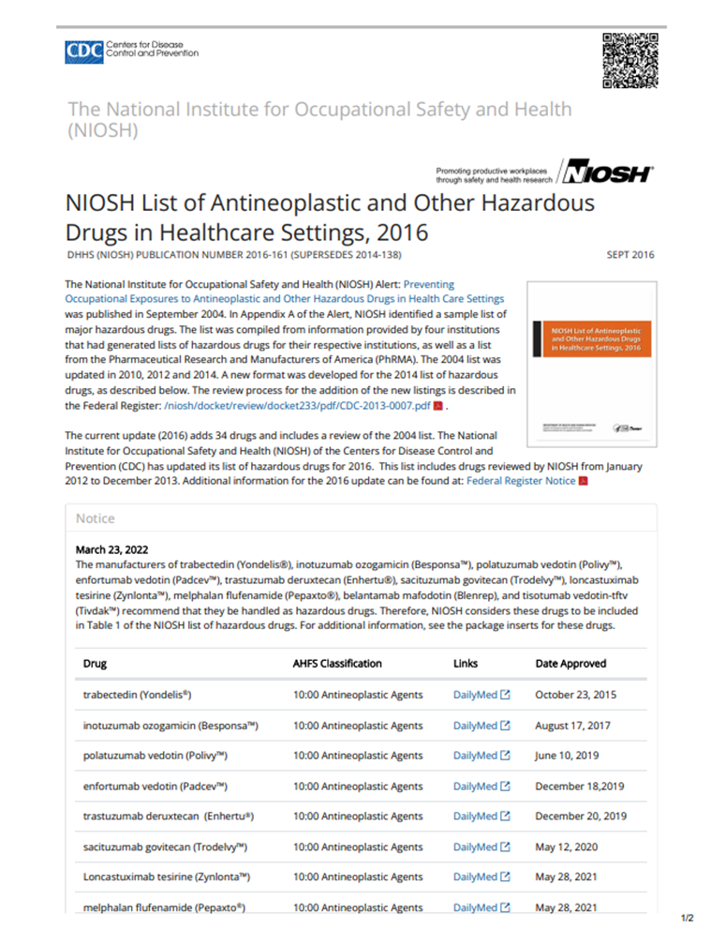
NIOSH Hazardous Drug List
Revised 2016, new draft in 2020
Hazardous drugs noted as:
  carcinogenic hazard,
  developmental hazard,
  reproductive hazard,
  genotoxic hazard, or
  other health hazard
No dose information
No potency categorizations or OELs
https://www.cdc.gov/niosh/docs/2016-161/default.html, accessed 11/9/22
Notes:
I also want to touch on the NIOSH Hazardous Drug List.
Pharma toxicologists and industrial hygienists can provide valuable input and clarity around these drugs due to our experience and skillsets.
The dose makes the poison.

Slide 68
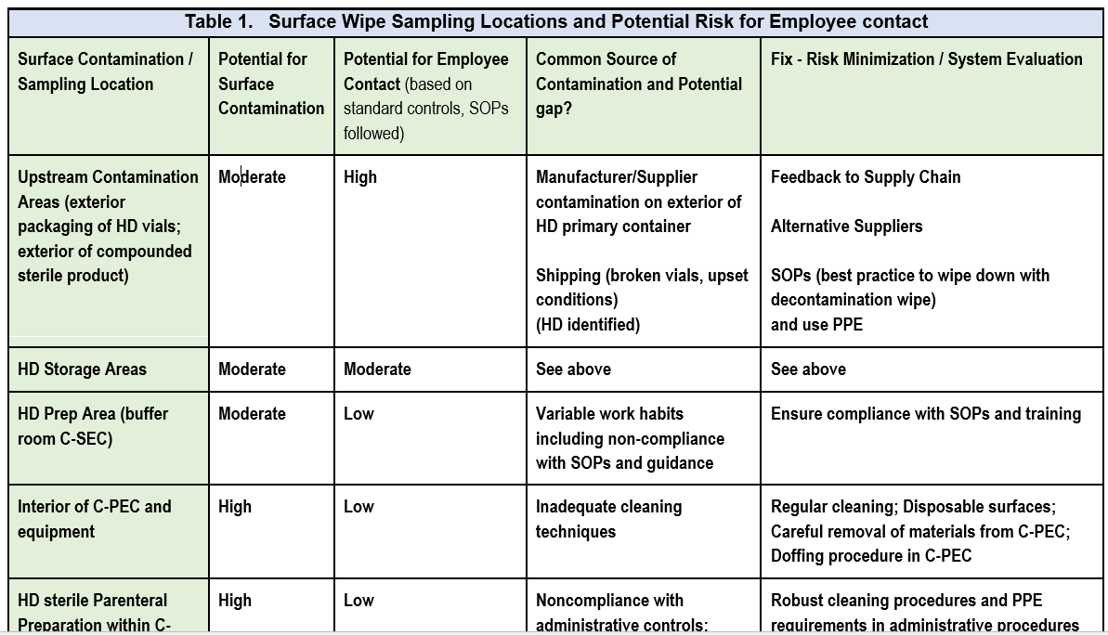
AIHA Surface Contamination Guidance Document - Risk Assessment Table
Guidance on surface contamination in healthcare settings.
Portion of document dedicated to ASLs.
Coming soon!
DRAFT
AIHA Healthcare Working Group
Notes:
Important work: assist w/surface contamination assessments under USP 800: AIHA Healthcare Working Group.
Multi-disciplinary volunteer team.
Guidance on surface contamination in healthcare settings.
Portion of document dedicated to ASLs.
Draft document to be peer reviewed. Publication anticipated in December 2022
Containment Primary Engineering Controls (C-PEC)
________________________________________________
An important body of work that will assist with surface contamination assessments under USP 800 comes from the American Industrial Hygiene Association (AIHA) Healthcare Working Group. This group is a multi-disciplinary volunteer team including hygienists (public and private sector), toxicologists, pharmacists, academic researchers and regulatory SMEs. This team has developed guidance on surface contamination in healthcare settings. A portion of this document is dedicated to acceptable surface limits (ASLs).
The draft document will soon be peer reviewed. Publication is anticipated in December 2022
Cross functional team
Hygienists
Pharmacists
Toxicologists
Analytical Chemists
Academic Researchers
Regulatory SMEs
Portion of document dedicated to ASL
American Industrial Hygiene Association (AIHA) Healthcare Working Group
Multi-disciplinary volunteer team by definition
Hygienists (public and private sector), Toxicologists, Pharmacists, Academic Researchers, Regulatory SMEs

Slide 69
Objectives: Review
What are potent compounds?
What Business Drivers make IH in Pharma challenging?
What ideas can I take to my job for possible implementation?

Slide 70
What are potent compounds?
Categories 3 and 4
⬥ Category 3 Potent / Toxic: (OEL 0.03 – 10 µg/m³)
⬥ Category 4 Highly Potent / Highly Toxic: (OEL ≤30 ng/m³):
ADCs
Low OELSs!
The dose makes the poison
HDs

Slide 71
What Business Drivers make IH in Pharma challenging?
Need for speed to market
Lack of tox data in early stages
Facility design issues if EH&S is not integrated

Slide 72





Ingredients for Success
What ideas can I implement at my job?
Proactive collaboration: IH, experts in toxicology, engineers, researchers
Proactive Management mindset
Understand stakeholder needs/teamwork
Learn from incidents
Notes:
To conclude,
Proactive collaboration: key to successful IH programs in pharma.
Management’s mindset: incorporate EH&S aspects into the business to add value and minimize disruptions.
Efforts at being proactive often challenged by business drivers to move quickly.
Understanding needs of our colleagues to get work done, while helping ALL to learn from incidents, are key success factors.
That concludes my talk. Thank you for your attention.
_______________________________
To conclude, proactive collaboration is key to successful industrial hygiene programs in pharma. Management’s mindset needs to incorporate EH&S aspects into the business to add value and minimize disruptions. Our efforts at being proactive are often challenged by the business drivers to move forward quickly. Understanding the needs of our pharma colleagues to get their work done, while helping ALL to learn from incidents, are key success factors.
That concludes my talk. Thank you for your attention.

